Slide 1
CWA Advanced Class Notes
Joe Attili – AA2IL
Jim Mueller - N7AUE
September-October, 2025

Slide 2
Session 0
Meet and Greet
Introduce ourselves
  Name, QTH, Rig/Station, Interests ...
  Have you been in the CWA B4?
Test Jitsi and Sidetone audio
  No time limit on Jitsi “free” account
  No special audio settings
  Jitsi seems to prioritize audio over video when allocating bandwidth
Do the first set of h/w assignments before the first class on Monday

Slide 3
Overview
8-weeks (Monday & Thursday evenings in North America, 6-7PM on the West Coast (0200-0300 UTC Tu & Fri)
  MST follows immediately after on Mondays
  We would like to have an (optional) on-air rag-chew session after class on Thursdays on 40m
  Please use headphones!!!
Daily Practice
  Two or three 15-minute sessions per day is much more effective than one 4-hour block once per week
  Homework: Short stories, Short and Long QSOs, CWT and POTA exchanges, common letter groups
  Practice sending also! We will discuss this more on Monday
  Software: RufzXP and MorseRunner
    There is a “community edition” of Morse Runner that includes several different contest formats
    DO NOT use any special lists of call signs!
  GET ON THE AIR!!!
    SST, MST and CWT are great contest practice
    Rag Chews!!!
    In-class exercises will reinforce skills but are no substitute for practice and OTA time
We will supplement each class with related topics to help improve your operating skills and overall enjoyment of our great hobby

Slide 4
Course Topics
Sending
Practice Mini-tests: SST, MST CWT
Hit-and-Run and Short QSOs
Rag-chewing
Logging
Chasing DX
Cut Numbers
DX Cluster and RBN
Contesting “tips and tricks”
CW Ops
???

Slide 5
Our Philosophy
Its a hobby, not a competition or a vocation
  Keep it fun!!!
Just like on the air (OTA), there are different skill levels coming into this class
  Compare yourself only to yourself, not your classmates
  Don’t get frustrated or worry about slowing down your classmates
    All of us, even the CW “speed demons,” have been where you are now
  More skilled ops, PSE QRS! GET THE MESSAGE THROUGH!!!
Challenge yourself
  Listen to the homework a little faster than you are comfortable with
  Strive to make a few more QSOs in the CWTs
  Try “running” in the SSTs and MSTs
  Practice sending a little faster …
Practice, Practice, Practice, get OTA and HAVE FUN!!!
Initial In-class activities will focus on contesting at first and build up to longer QSOs

Slide 6
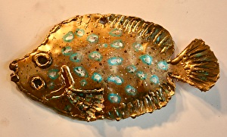
About AA2IL
Grew up in Upstate New York
  Job Transfer brought me to San Diego in 1993
  Current QTH is in a rural area in the foothills Northeast of SD
First licensed in the late 1970s as a teenager
  Went silent for over 20-years
Retired in Oct. 2021 after 35-years as an Electrical Engineer (signal processing)
Radio activities include
  Chasing DX and contesting
  VHF/UHF and satellites
  Antennas, Linux software development and micro-controllers
Modest HF station
  Main rig is an FTdx3000, no amplifier
  100W and wire antennas
I took this class in spring 2002
  Biggest take-away was how crucial daily practice is to improving speed
Go Brass Flounders!

Slide 7
Homework
CWA has recently revamped the homework assignments for all class levels
We will be “loosely” following the Ver2.2 prototype
  The prior 1.x series emphasized contesting
  The new 2.x series emphasizes head-copy and rag-chewing with very little contesting content
We will give suggested assignments which attempt to strike a balance between rag-chewing and contesting
  Read the comments in the Ver2.2 document – they are quite helpful!
  You are free to follow what ever path fits your interests and time constraints
  We highly recommend that you spend some quality time with Morse Runner and RufzXP to build up ICR

Slide 8
Homework for Monday
Day 1 (Thursday) – Emphasis in on Head Copy: Rag Chewers Should Emphasize these
  Short Phrases PR 101-20
  Short Words WD 101-20.
  Suffixes ING4-20, ED4-20, ES4-20 and LY4-20
  Short Story SS 301-20
Day 2 (Friday) – Emphasis is on Contesting: Contesters & POTAers Should Emphasize these
  POTA 101-20
  CWT Chapter 01 - This is a simulation of a typical CWT “Runner.” He is sending “CQ CWT” to solicit contacts and answering callers one after another. There will be three different stations he works and he will repeat his exchange (name and number OR state) each time. So, you have three opportunities to capture his call, his name and his number each time you play the file. Take as many times as you need to get all three pieces of info and write them down. Can you also copy the info for each caller?
  RufzXP - Set starting speed at 15 wpm and do a full cycle until it ends. Type in call signs as you copy them, and note your result at the end of the session.
  Morse Runner - Set speed at 20 wpm, using “single call” mode (pull down “run” tab and select “single calls”). Set “run for” time at 20 minutes. Note your results at the end of the session.
Day 3 (Saturday) – Emphasis is on Rag Chewing: These are the Top Priority for Everyone
  Short and Long QSOs – QSO 101–20 and QSO 301-20 (Along with the Short Stories)

Slide 9
GitHub Repository
I have set up a repository on GitHub for items related to CW and this class:
  https://github.com/aa2il/CWA
The final slide decks for our previous classes are available
There are “old” versions of the CWA Practice files which you can use for additional practice material:
  “OLD Advanced QSOs”
  “OLD Advanced Short Stories”
The sub-folder “N1MM” contains a collection of “quick-start” guides for N1MM logger
  N1MM is the most popular contest logging program but certainly not the only one available
The file “Panagrams.pdf” contains a long list of panagrams you can use for sending practice.
  Panagrams are helpful in that they hit each letter of the alphabet at least once
Poke around and feel free to suggest other material to include there
Get an audio player that allows you to change the replay speed (e.g. audacity)

Slide 10
CW Ops CW Open
Three 4-Hour Sessions Friday Night and Saturday
CWT on Steroids
Try listening and see what you can pick up
Exchange: Serial No. and NAME (Opposite order of MST)
    CQ TEST AA2IL
                N7AUE
    N7AUE TU 123 JOE
                TU 456 MULEY
    GL AA2IL
If you miss something: ?, AGN?, CALL?, NAME?, NR?, N7?, AUE?, ..

Slide 11
Week 1 - Session 1
Go over Homework and On-The-Air (OTA) activities
We’re heading into the fall/winter contest season:
  SKCC Sprintathon Straight keys, bugs and side-swipers only, no paddles/keyers
  NA Sprint CW Exchange is COMPLICATED!
  ARRL VHF+ Exchange is Grid Square (4-chars)
    <SOAPBOX> PSE USE PROPER PHONETICS !!! </SOAPBOX>
Get on the air!
  There’s always rags to chew, DX/POTA/SOTA/SES stations ...
Sending
Word game drill
  Animals
  Colors

Slide 12
Homework for Thursday
PRACTICE SENDING EVERYDAY!!!!!
Day 1 (Tuesday) – Emphasis in on Head Copy: Rag Chewers Should Emphasize these
  Short Phrases PR 102-20
  Short Words WD 102-20.
  Suffixes ING5-20, ED5-20, ES5-20 and LY5-20
  Short Story SS 302-20
Day 2 (Wednesday) – Emphasis is on Contesting: Contesters & POTAers Should Emphasize these
  POTA 102-20
  CWT Chapter 02 – What is the call, name and member number for the Runner? What are the calls of the stations he responds to?
  Monitor any session of CWT (Wed 1300Z, 1900Z, Thu 0300Z or 0700Z) and tune around, finding stations that are “running” (e.g. staying on a frequency and soliciting calls). Try to decode at least 10 different running stations, and jot down:
    The call sign, name and number OR state info for each (e.g. K6RB Rob 3)
  They will be going quite fast so don’t get frustrated. Just sit on the frequency and listen, listen and listen some more. You’ll get it.
Day 3 (Thursday) – Emphasis is on Rag Chewing: These are the Top Priority for Everyone
  Short and Long QSOs – QSO 102–20 and QSO 302-20 (Along with the Short Stories)

Slide 13
CW Sending
Sending clean and crisp code is as important as copying
  Your “fist” is your signature on the air
General rule of thumb is to never send faster than you can comfortably copy
  Will depend on conditions and context
As you head copy skills improve, you will likely outpace your “clean” sending speed
Most CONTEST OPS are using a computer for sending
  You are encouraged to do this, especially in fast-paced events like the CWTs
However, a well-rounded CW operator must have a decent “fist” so you need to devote time to practicing sending
For class sessions, keep your speed under 18-20 WPM!!!

Slide 14
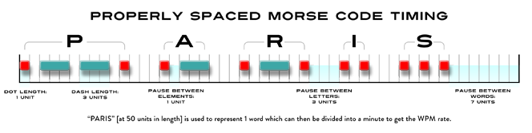
T = Duration of a dit (seconds)
“Paris” is the “standard” word length = 50 dits
WPM = No. Times we can send this standard word in a minute = 60 sec. / (50 T)
T = 1.2/WPM seconds
e.g. For 25 WPM, each dit is 1.2/25 = 0.048 s = 48 ms

Slide 15
Strive for a Good “Fist”
Joy to Copy
Make a concerted effort to use proper spacing
  Use the space between words to “send ahead” the next word
    TU JOE 3177
    THE QUICK BROWN FOX JUMPED OVER THE LAZY DOG
  The hardest fists to copy have poor/little/no spacing
    TUJOE3177
    THEQUICKBROWNFOXJUMPEDOVERTHELAZYDOG
  Extra spacing between words is fine BUT within words is much harder to head-copy
    TU J OE 31 77
    THE QU ICK BROW N FOX JUMP ED OVER THE LA ZY DO G
Occasional errors are expected BUT slow down if you are making too many errors …
  Or your partner is asking for a lot of repeats or conditions deteriorate or ...
We are using paddles and electronic keyers in this class but if you also use a straight key or a bug, concentrate on ~3:1 weighting for dahs vs dits
  Significant under weighting is very hard to copy
  Bugs often result in over-weighting but can be readily copied

Slide 16
Sending Practice Ideas
Devote at least 10 min. each day to practicing with your paddles
List of Panagrams
List of Call Signs (e.g. from DX Cluster)
Look around the room and/or send whatever comes to mind or what you might say in a QSO
BEST: Get on the air and rag chew
Use your paddles in SST or POTA activations
Try sending slightly above your comfort zone (off the air)

Slide 17
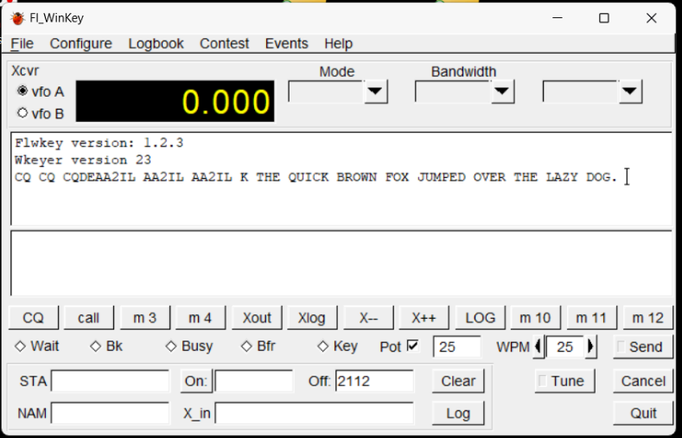
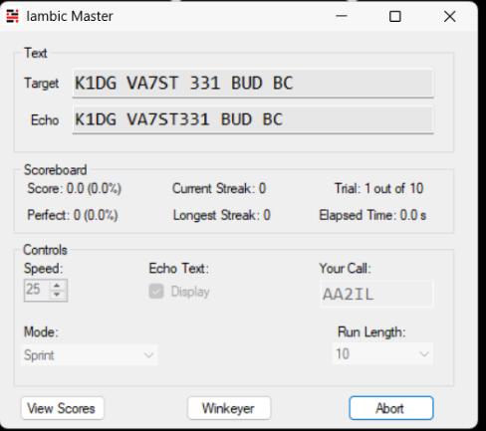
Evaluate Your Fist
Easy/cheap to “role your own” keyer that works with these programs
Listen to a recording of yourself
Programs exist that evaluate your sending
  Iambic Master + Winkeyer
  FLwkey + Winkeyer
  Morseino
  G4FON Trainer, ...

Slide 18
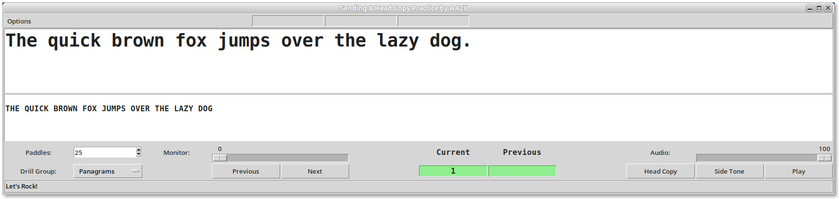
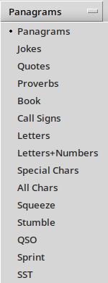
Paddling Practice With
My Keyer
Python code is available at https://github.com/aa2il/pyKeyer
Runs under Linux and Windoz
  See README.md and the Draft User’s Manual
Works with Winkeyer

Slide 19
Sending Homework
Try one or more of the suggested programs to find one that suites you and your hardware
Download a program such as Audacity (or a similar app for your phone) which will allow you to record yourself and play it back
  You can use Audacity to adjust speed of CWA practice mp3s as well
Each day:
  Warm-up scales
  Send several panagrams at a speed you are comfortable at both sending and receiving
  Run through a “mock” rag chew off-the-air
  Best practice is to get on the air and make some friends!!!

Slide 20
“Squeeze” Sending
CWops encourages use of paddles and electronic keyers
  Cleaner fist at faster speeds
  Most ops “hit a wall” at 15-20 wpm using a straight key
  Eventually, you will hit a wall with a keyer also → keyboard sending
There are two types of paddles
  Single lever
  Dual lever
With a dual lever paddle, you can “squeeze” the levers together to form letters with alternating dit/dah patterns:
  Reduces number of “motions” required to form a symbol
  A, C, K, N, R, period, …
  Can even combine squeeze technique with “non-squeeze” to form most other symbols
    L, F, Q, Y, ...

Slide 21
“Squeeze” Sending (cont.)
If you don’t “squeeze,” there is no real difference between single and dual-lever paddles
The advantage of squeezing dual-paddles over a single-lever paddle is not nearly as much as using an electronic keyer over a straight key
  The HST guys use single-lever paddles because less prone to making mistakes
There are two Iambic “squeeze” modes:
  Mode A: Sending stops after current element is sent
  Mode B: You can send a trailing dit by closing the dit paddle during a dah
Excellent video demonstration by AA4OO:
  https://www.youtube.com/watch?v=6R4t3Wq1Gic

Slide 22
Homebrew Arduino Nano
Keyer/Code Practice Oscillator
A number of keyers are commercially available and are quite popular, e.g.
  Winkeyer
  Morseruino
You can easily “roll your own” using a micro-controller (Arduino, ESP-32, ...)
  This is a much cheaper option, especially if you have a well-stocked junk box
  K3NG Keyer – Has every feature imaginable and includes Winkeyer emulation
  Fldigi Nano IO (W1HKJ) – easily fits in an Arduino Nano
I use adaptations of both the Nano IO and K3NG/Winkeyer emulator
  Full schematics and firmware source are available at https://github.com/aa2il/nanoIO
  Doubles as a code practice oscillator and gives you feedback on your timing
  Minimal parts count

Slide 23
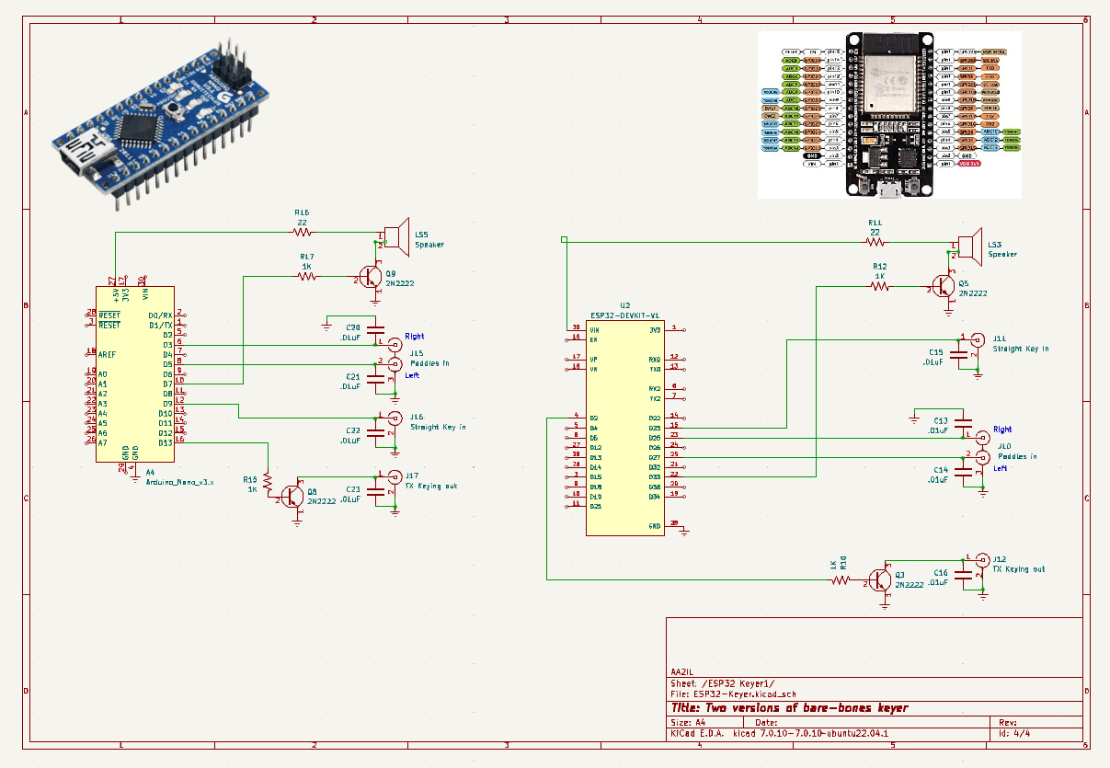

Slide 24
Week 1 - Session 2
Questions on h/w & on the air activities?
We’re heading into the fall/winter contest season:
  SKCC Sprintathon Straight keys, bugs and side-swipers only, no paddles/keyers
  NA Sprint CW Exchange is COMPLICATED!
  ARRL VHF+ Exchange is Grid Square (4-chars)
Contesting Intro + SST
Drill: Simulated SST
  Each student gets to run and others call
  Muley and I might just jump in on this one
  Set your keyer to 18-20 WPM

Slide 25
Homework for Monday
PRACTICE SENDING EVERYDAY!!!!!
Day 1 (Thursday) – Emphasis in on Head Copy:
  Short Phrases PR 103-20
  Short Words WD 103-20.
  Suffixes ING5-20, ED5-20, ES5-20 and LY5-20
  Short Story SS 303-20
Day 2 (Friday) – Emphasis is on Contesting:
  POTA 103-20
  CWT Chapter 03
  RufzXP - Set starting speed at 15 wpm and do a full cycle until it ends. Type in call signs as you copy them, and note your result at the end of the session.
  Morse Runner - Set speed at 20 wpm, using “single call” mode (pull down “run” tab and select “single calls”). Set “run for” time at 20 minutes. Note your results at the end of the session.
Day 3 (Saturday) – Emphasis is on Rag Chewing:
  Short and Long QSOs – QSO 103–20 and QSO 303-20

Slide 26
Miscellaneous Leftovers
Read over notes from Monday regarding “Squeeze Sending” and rolling your own keyer
Jitsi: You can use the SPACE BAR as a PTT
The September VHF+ Contest is this weekend
  Exchange is 4-character maidenhead grid square (e.g. DM12)
  Look for CW activity 50.09 MHz +/- and 144.2 MHz +/-
  Look for SSB activity around 50.125 MHz, 144.2 MHz and 432.1 MHz, all +/-
  Look for FM activity around the calling frequencies: 144.52 MHz and
  446.0 MHz (Check the rules!)
  FT8 dominates 6m with sporadic activity on 2m and 70cm
Morse Runner CE incorporates several different contests
  https://github.com/w7sst/MorseRunner
If you have a Winkeyer, Iambic Master and FLwkey are programs to help you with your sending:
  https://sites.google.com/site/korkowp1/iambic-master
  http://www.w1hkj.com

Slide 27
VHF+ Contesting
Several times each year – January, June, July and September
All modes, work each station once per band regardless of mode
Propagation is MUCH more unpredictable than HF!
A common practice is once you make a contact with someone, ask them to move around to different bands
Exchange: 4-character Maidenhead Grid Square
    CQ TEST WE7DW
                VA4ADM
    VA4ADM CN85
                TU EN19
    73 VA4ADM
Pace is generally relaxed so friendly greetings & chatter are acceptable

Slide 28
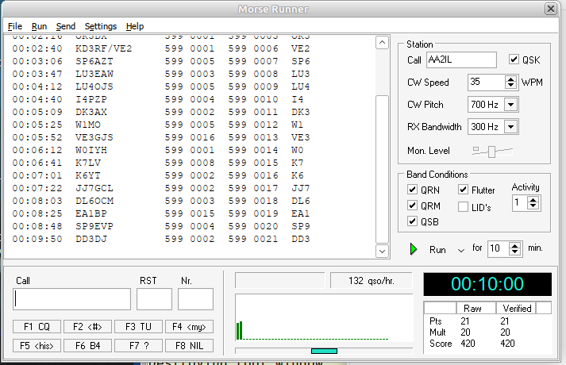
Morse Runner
Morse Runner is a realistic simulation of a contest environment
  Signal effects
  Multiple callers
  Lids, etc.
Experiment with the various
settings to find where you
are comfortable
  Initially, set the
  Activity level to 1 and
  turn off LIDs
Introduce more effects as
you become more proficient

Slide 29
Morse Runner Buttons
F1 = CQ You are the runner, use this to solicit a call
F2 = # Your Exchange (5NN + Serial Number)
F3 = TU Got it, 73, next caller please
F4 = My Call Shouldn’t need this too much
F5 = His Call Use this if you only copy part of a call
F6 = B4 Duplicate QSO, don’t use this, just work him again
F7 = ? Please again for a repeat
F8 = Nil Incomplete/invalid QSO - Rarely ever need this
F11 = Wipe Wipe everything - Rarely ever need this
F12 = Send Number Rarely ever need this in MR
Others???

Slide 30
Why Radio Sport?
Major activity in our hobby
Fun Competition
  Some say its the most fun you can have with your clothes on
Become a better operator
  Difficult conditions
  Emergency Comms
Quickly rack up entities for “paper chasing” (WAS, DXCC, DX Challenge …)
  Regular Participation in CWTs is easiest path to CWops membership
Dormant bands suddenly light up
Test effectiveness of your station
…

Slide 31
Some Terminology
Runner
  Station Calling CQ to solicit contacts
  Usually achieve a higher QSO rate, especially if you are a “big gun”
  Need to be able to recognize calls and exchanges without too many repeats
Search and Pounce (S&P)
  Tune across band answering runners
  Often lower rate because you are tuning and competing with other S&Pers
  Much easier than running since you can listen to runner until you get call and info
    Be careful with serial numbers as they are not always consecutive
    If you are “assisted,” Trust but Verify call sign
  Often a better strategy for “little pistols” in larger contests
Some mix of these is needed to work everybody
  I do a lot of this

Slide 32
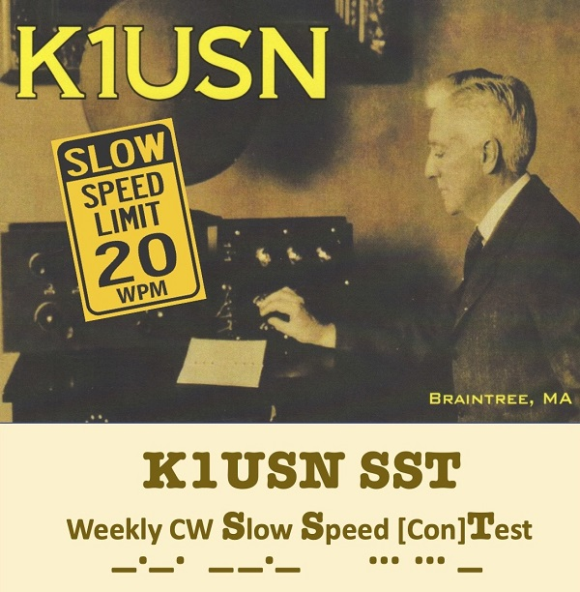
SST Weekly Practice Contest
“Slow” Speed Test
Friday 2000z and Monday 0000z
Very Relaxed Pace - Speed limit is 20 wpm
Exchange: NAME and STATE/PROVINCE
    CQ SST AK4R
                K7NX
    K7NX TU STEVE TN
                GE LLOYD AZ or GE STEVE LLOYD AZ
    GL LLOYD 73EE
If you miss something: ?, AGN, CALL?, NAME?, QTH?, K7?, NX? ...
Great place to get used to contesting and to try running

Slide 33
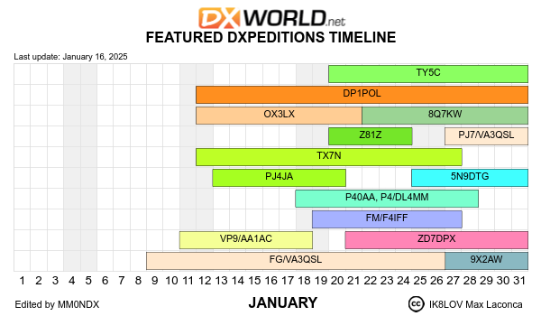
Week 2 - Session 3
Go over h/w and on air activities
We’re in the middle of the winter contest season:
  CQ 160m CW
  Winter Field Day
  www.contestcalendar.com
DX:
  TX7N, others
  www.dx-world.net
More Contesting + MST

Slide 34
SST vs NAQP
Extra greetings and “chatter” are perfectly acceptable (and encouraged) in the SST (and MST)
Exchange for both SST and NAQP is NAME and STATE/PROVINCE but for the NAQP, keep messages concise:
    CQ NA KF0PQR
                KS4BG
    KS4BG JEFF CO
                TU EDGAR TN or ED TN
    TU KF0PQR
In a “real” contest (and even the CWT), avoid extra “fluff” in exchanges:
  “Serious” competitors often use X, R or DIT-DIT instead of TU
  No “flow control,” e.g. K, BK, TNX FER TN, …
    These actually disrupt the rhythm of the runner
  Send exchange elements only once unless you think your signal is weak
    Use STEVE STEVE TN TN instead of STEVE TN STEVE TN
  If you’re running and think another caller is waiting, don’t send your call sign after the TU/R/EE
  Short and sweet

Slide 35
Some More Terminology
SO1R/SO1V – Single Operator, One Radio/One VFO
  Most of us mere mortals
SO2V – Single Operator, Two VFO’s
  One transmitter and two receivers (one in each ear)
SO2R – Single Operator, Two (or more) Radios
  Generally running on one radio and searching for multipliers on the other
2BSIQ – Two-band Simultaneous Interleaved QSOs
  Running on two bands, alternating CQ calls
Multi-Operator
  Larger contest stations with two or more ops

Slide 36
Some Contest DOs ...
Start off S&Ping until you build up skills and confidence
  This is all many ops ever do
If you are running, ask for a repeat if you have any doubt about what you copied
  You only get one chance at the caller
If you are S&Ping, you can either ask for a repeat or just listen to his next QSO
  Be careful about serial numbers!
  When you are starting out, listen before and after so not to slow down runner
When you ask for a repeat, try to be specific which element that you missed
  NAME?, NR?, QTH?
If the runner mangles your call, send it again then give your exchange
  Courtesy demands that we look out for each other
Be courteous but concise
QRS if a caller is slower or conditions are difficult (e.g. flutter or multipath)
After the contest, record your claimed score at 3830scores.com and submit your log to contest sponsor

Slide 37
… and DON’Ts
Don’t send unnecessary information:
  Runner’s Call
    He knows what it is and its your problem if you are S&Ping and get it wrong!
  DE before your call or NR before your Serial Number
    Wastes time, throws off timing and can be confusing
  Signal report if it is not part of the contest exchange
  Anything other than 5NN (or ENN) if a signal report is required
  “Flow control” prosigns, e.g. K, BK, ...
  Long greetings/chatter:
    SST and MST are exceptions as friendly greetings are encouraged
    I do like to send a quick comment to people I know
    Some contests are very slow, e.g. VHF+, so chatter is acceptable
Bottom line is we want to keep things moving!!!

Slide 38
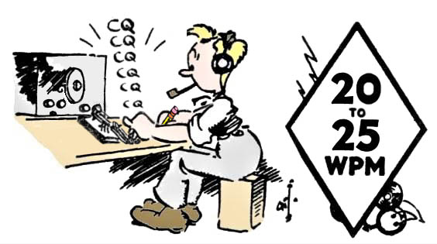
MST Weekly Practice Contest
ICWC Medium Speed Test
Monday 1300z and 1900z, Tuesday 0300z
Relaxed Pace - Speed limit is 25 wpm
Exchange: NAME and SERIAL NR
    CQ MST KZ5H
                WA2USA
    WA2USA TU SETH 28
                TU DENNIS 17
    TU DENNIS 73 KZ5H
                N7AUE You don’t need to wait for another CQ
    N7AUE TU SETH 29
                TU SETH MULEY 24
    TU MULEY 73 KZ5H
Don’t use “cut” numbers
QRS for slower ops
Another great place to build up confidence and skill

Slide 39
Week 2 - Session 4
Questions on h/w & on the air activities?
  Short Story was on Sending!
New “Short” Practice files have been rolled out:
  Words, Phrases, POTA
Contests this weekend:
  CQ 160m CW
  Winter Field Day
Tonight: Cut Numbers

Slide 40
Cut Numbers
Acceptable:
  0 → T
  1 → A
  9 → N
Creative (Avoid Using These!):
  0 → the letter O
  5 → E
  2 → U 3 → V NO!!!!! Sound too much like 4
  8 → D 7 → B NO!!!!!! Sounds too much like 6
CQ WPX (e.g. Morse Runner):
  599 → ENN (signal report)
  1920 → AN2T (serial number)
  Some ops are very creative!

Slide 41
Cut Numbers (cont.)
In the CWTs and many of the larger contests (e.g. CQ WW, Intl DX), you will hear ops use abbreviations for numbers in the exchange
  599 → 5NN or <ENN> (Dummy signal report)
  11 → AA (CQ Zone 11 – Brazil – CQ WW)
  15 → A5 or AE (CQ Zone 15 – Italy - CQWW)
  100 → 1TT or ATT (100 Watts – International DX)
  99 → NN (99 Watts – International DX)
  1000 → K or KW (1 Kilowatt – International DX)
  1090 → ATNT (N4FP’s CWT Member No. - CWT)
  2198 → UAND (N5OT CWT Member No. - CWT)

Slide 42
Cut Numbers (cont.)
Other than the dummy signal report (5NN or ENN), I don’t like this practice and advise against it
  Eliminates the inherent redundancy which is very helpful in the presence of QRM and QSB
  Generally leads to more “fill” requests (repeats)
  However, others use it so you need to understand it!
I find the easiest way to deal with a cut number is to log it and unwind the actual meaning later
One place where a cut number can be somewhat useful is if you enter a contest late, you can send a leading “T” in your serial number to alert the other station to this:
  4 → T4 or TT4
I advise against sending leading zeros for numbers above 9
Don’t send TT7 or T25 in MST, just 7 or 25 – very few ops get over 100 Q’s in the MST!
Never use cut numbers on RTTY – actually makes transmissions longer and more error-prone!

Slide 43
CW Math Drill
1 plus 2
Is 3 R 3 times 5
Is 15 R 15 div 3
? 15 div 3 Is 5 R 5 minus 1
Is 6 NO 5 minus 1 Is 4 R …
Etc.
Use ? Or AGN? for repeats and R to confirm answer
  Try not using “voice” since you can’t do that on the air
No Cut Numbers this time - We’ll do that next time

Slide 44
Week 3 - Session 5
Go over h/w and on air activities
This weekend:
  VT, MN, BC QSO Parties
  NA Sprint CW
Tonight:
  CWT
  CW Ops
  Sprint Contests
  Math drill with cut numbers

Slide 45
CWT Weekly Practice Contest
Wednesday 1300z and 1900z, Thursday 0300z and 0700z
Very popular and very fast – “average” speed ~39 wpm
Exchange: NAME and MEMBER No. or STATE or “CWA”
    CQ CWT AA2IL
                WA2USA
    WA2USA JOE 3177
                TU DENNIS IN or TU DENNIS CWA
    TU AA2IL or R or EE or TU (w/o my call)
Some ops will use every trick possible to shorten the exchange
  Cut numbers
  State instead of member number
  Send exchange at 50+ WPM
If you are aspiring to become a member of CWops, this is the easiest place to get your call recognized and build up the necessary sponsorship

Slide 46
The CWT is a Unique Beast
Goals for participants vary
  Make as many contacts as possible in an hour
  Sharpen or maintain skills
  Enjoy QRQ CW
  Try new equipment, h/w, s/w, techniques ...
Each session is only an hour and not scored
Most ops are using Call History
  Once you get call sign, you’ve know everything
  Generally no need to ask for repeats of exchange
Recommendations
  CWA Students should NOT use call history
  Check your copy against the Club Roster or Call History
  Don’t ask for repeats (CWT only)

Slide 47
CWops Membership
Requirements
Club to preserve and promote the art and use of CW
Demonstrate Proficiency at 25-WPM or higher
  Easiest way is to make several contacts in the CWTs
  You can also schedule contacts with current members to gain sponsorship (or call/answer CQ or have a “give-back” QSO or ...)
1-Nomination + 3-sponsors
  Worked you at least twice OTA in the past year
You don’t need to be perfect!
  Implicit is the understanding that you will continue to improve as you get more involved with the club activities
Dues: $15/yr or $60 for 5-years or $125 for life

Slide 48
NA Sprint Contests
Twice a year plus weekly practice sessions on Thursday evenings
The QSY requirements make these events quite different compared to a typical contest:
  If you call CQ, you must QSY at least 5-KHz before you can call CQ again
  If you pounce, you can answer one caller and then you must QSY at least 1-KHz
The order of the elements in the exchange indicates who is the CQer and who is the pouncer:
  CQ NA AA2IL
  N7AUE
  N7AUE AA2IL 123 JOE CA
  AA2IL 456 JIM NV N7AUE
  TU
  W0WL
  W0WL N7AUE 457 JIM NV
  N7AUE 789 JOE WA W0WL
  TU
See https://www.kkn.net/n6tr/sprint.html for an in depth look

Slide 49
CW Math Drill
1 plus 2
Is 3 R 3 times 5
Is 15 R 15 div 3
? 15 div 3 Is 5 R 5 minus 1
Is 6 NO 5 minus 1 Is 4 R …
Etc.
Use ? Or AGN? for repeats and R to confirm answer
  Try not using “voice” since you can’t do that on the air
Use Cut Numbers this time!

Slide 50
CW Math Ops
Plus: + .-.-. <AR>
Minus: - -….- or -...- <BT>
Times: x -..-
Div: / -..-.
Decimal Point . R or Period

Slide 51
Week 3 - Session 6
Go over h/w and on air activities
This weekend:
  State QSO Parties:
    VT - He sends 5NN + COUNTY - You send 5NN + STATE
    MN - He sends NAME + COUNTY - You send NAME + STATE
    BC - He sends 5NN + DISTRICT - You send 5NN + STATE
  NA Sprint CW
Tonight – Short “Ragchews”

Slide 52

“Hit and Run” QSOs
By convention, a valid QSO must exchange some type of information in addition to call signs
The minimal amount of “information” is a signal report (however meaningless it might be)
Example – A “rare” DX station running a pile-up:
  His goal is to work as many stations as possible
  Your goal is to bag that ATNO
  CQ 3B7M UP
                KF0PQR
    KF0PQR 5NN
                TU 5NN or 5NN 73 or 5NN CO
    R 3B7M UP
Contest exchanges (and FT4/8) obviously fall into the “Hit and Run” category

Slide 53
Short QSOs
Special Event, POTA, SOTA, etc. ops also are generally trying to work as many stations as possible so they might only send a 5NN signal report or 5NN + STATE
Some ops will exchange more meaningful information quickly (e.g. Actual RST+STATE+Op NAME+Park ID)
Example – A not-so-rare DX station who’s not in a hurry:
  CQ DX CQ DX SV2HUD SV2HUD
                WA2USA WA2USA
  WA2USA GM 559 OP VAS VAS BK
                GM VAS UR 569 569 IN IN OP DENNIS DENNIS BK
  QSL DENNIS TNX ES 73 CU K
                TU VAS 73 GL K
He may or may not want to engage further depending on conditions (QSB, QRN, etc.) or demand
Can usually get away with sending only your call

Slide 54
Rag Chew QSOs
There’s no precise definition for a “rag chew” QSO but they generally begin with “the big three”
  Signal Report (RST)
  Location (QTH)
  Name (OP)
  CQ CQ CQ DE AA2IL AA2IL AA2IL K
  AA2IL DE KB1FGC KB1FGC KN
    KB1FGC DE AA2IL = GE OM ES TNX FER CALL = UR 57N 57N IN RAMONA, CA RAMONA, CA, ABT 30 MILES NE OF SAN DIEGO = NAME HR IS JOE JOE = HOW CPY? <AR> KB1FGC DE AA2IL <KN>
  AA2IL DE KB1FGC RR FB JOE TNX FER RPRT, SOLID COPY = UR RST 55N
  55N = OP RICH RICH ES QTH PROSPECT, CT PROSPECT, CT = SO HW? BK
Typical 3x3 CQ
Send his call so he knows you want a contact AND your call 2 or 3 times

Slide 55
Rag Chew QSOs (cont.)
At this point, we can continue the QSO or politely end it:
  KB1FGC DE AA2IL = RR SOLID CPY RICH ES GUD TO MEET U = XYL IS RINGING DINNER BELL SO MUST SAY 73 FOR NW = HPE CU AGN SN = 73 <SK> KB1FGC DE AA2IL <KN>
  AA2IL DE KB1FGC = FB JOE TNX FER QUICK CHAT ES WILL LOOK FER U AGN 73 73 <SK> AA2IL DE KB1FGC K EE
  EE
There is a lot more detail than in a “Hit an Run” QSO
A lot of jargon and abbreviations are used to shorten the messages
I like to use the “break” or “double dash” (=,<BT>) to separate various thoughts and also to bide a little time while I’m thinking of the next thing to say
I also like to use accepted pro-signs to help with flow of transmissions

Slide 56
Common Abbreviations
ABT | About |  | FT | Feet |  | PWR | Power |  | WX | Weather
AGN | Again |  | GA | Good afternoon |  | R | Roger, Decimal point |  | XCVR | Transceiver
ANT | Antenna |  | GB | God bless |  | RIG | Radio equipment |  | YL | Young lady
B4 | Before |  | GBA | God bless America |  | RPT | Report |  | YR | Year
BK | Back to you |  | GD | Good day |  | RPRT | Report |  | YRS | Years
BTU | Back to you |  | GE | Good evening |  | RCVR | Receiver |  | XYL | Wife (Ex-young-lady)
BURO | QSL Bureau |  | GL | Good luck |  | RX | Receiver |  | 73 | Best regards
C | Yes (“Si”) |  | GM | Good morning |  | SIGS | Signals |  | 88 | Hugs and Kisses
CONDX | Conditions |  | GN | Good night |  | SRI | Sorry
CPY | Copy |  | GUD | Good |  | TKS | Thanks |  | <AR> | End of Message
CU | See you |  | HI | Laugh |  | TNX | Thanks |  | <AS> | Stand by
CUL | See you later |  | HPE | I hope/I hope to |  | TU | Thank you |  | <BT> | Break
CQ | Calling anyone (“Seek You”) |  | HR | Here |  | TX | Transmitter |  | K | Go (anyone)
DE | From (“de”) |  | HW | How |  | U | You |  | <KN> | Go only
DR | Dear |  | LID | Bad operator |  | UR | Your/You’re/You are |  | <SK> | End of contact
DX | Long-distance |  | NIL | Nothing |  | URS | Yours
EL | Element |  | NR | Near |  | VERT | Vertical |  | BN | BEEN
ES | And |  | OM | Old Man |  | VY | Very |  | MT | MEET
FB | Fine business |  | OP | Operator |  | W | Watt(s) |  | And so on | And so on and so on …..
FER | For |  | PSE | Please |  | WID | With

Slide 57
Week 4 - Session 7
Congrats to Seth and Lloyd – No.s 3667 and 3668
Go over h/w and on air activities
On The Air:
  CQ WPX RTTY
    599 + Serial Number
    Everybody works everybody
  Contestcalendar.com
  Contest sponsor usually has website also, e.g. cqwpxrtty.com
More Rag chewing

Slide 58
Rag Chew QSOs
There’s no precise definition for a “rag chew” QSO but they generally begin with “the big three”
  Signal Report (RST)
  Location (QTH)
  Name (OP)
  CQ CQ CQ DE AA2IL AA2IL AA2IL K
  AA2IL DE KB1FGC KB1FGC KN
    KB1FGC DE AA2IL = GE OM ES TNX FER CALL = UR 57N 57N IN RAMONA, CA RAMONA, CA, ABT 30 MILES NE OF SAN DIEGO = NAME HR IS JOE JOE = HOW CPY? <AR> KB1FGC DE AA2IL <KN>
  AA2IL DE KB1FGC RR FB JOE TNX FER RPRT, SOLID COPY = UR RST 55N
  55N = OP RICH RICH ES QTH PROSPECT, CT PROSPECT, CT = SO HW? BK
Typical 3x3 CQ
Send his call so he knows you want a contact AND your call 2 or 3 times

Slide 59
Rag Chew QSOs (cont.)
If we both choose to continue the conversation, there are a lot of things to talk about:
  Rig, antennas, radio adventures/exploits, …
  Weather, your city, ...
  Age, work, family ...
  KB1FGC DE AA2IL = RR SOLID AGN = RIG HR IS A YAESU FTDX300 ABT 100W TO A MOXON BEAM UP 30 FT = WX HR TODAY SUNNY AND HOT, TEMP NR 100 DEG F = SO BTU RICH <KN>
  R FB JOE DIDNT MISS A DIT = UR RIG AND ANT DOING NICE JOB HR IN CT = RIG HR IS KNWD TS2000 WID AMP RUNNING 500W TO A DIPOLE UP 45 FT = WX HR IS COOL AND RAIN, TEMP IN LOW 50S = FALL IS HR IN THE GREAT NE = BTU JOE KN
  VY GUD RICH = I GREW UP IN UPSTATE NY AND MISS THIS TIME OF YR = WENT TO THE BEACH WID MY XYL YESTERDAY TO REMIND US WHY WE LIVE HR HI HI = I RETIRED LAST YR AFTER 35 YRS AS AN ELEC ENGR = NW I HV LOTS OF TIME TO PLAY RADIO = WHAT DO YOU DO FOR WRK RICH? <KN>
  AA2IL DE KB1FGC R SOLID AGN JOE = MY FAMILY RUNS AN ANTIQUE TRUCK MUSEUM AND I USED TO DRIVE BIG RIGS = BEEN A HAM FER 25 YRS, I ENJOY CW RAG CHEWING AND CHASING DX. I ALSO LIKE TO REPAIR VINTAGE RIGS AND IM WORKING ON A SATELLITE SETUP
  ...

Slide 60
Rag Chew QSOs (cont.)
… and so on and so on
Be sure to identify every 10-minutes
Keep subject matter friendly and upbeat and non-controversial
  Avoid subjects like religion, politics, etc.
  CW is not Social Media (or 80m Phone!)
Keep exchanges relatively short – don’t dominate the conversation

Slide 61
Rag Chew Drill
For practice tonight, operate as if you’ve met the other op before::
  CQ CQ CQ AK4R AK4R K
  AK4R DE KF0PQR KF0PQR KN
  KF0PQR DE AK4R = GE JEFF ES GUD TO CU AGN = UR 57N 57N IN TN = HOW? BK
  RR HI STEVE, GUD TO HEAR U ALSO = UR 5NN IN FT COLLINS, FB SIG = RIG HR IS ICOM 7300 100W TO A VERTICAL ON MY TRUCK = WX HR IS COLD AND SNOW, TEMP IN LOW 30S = BTU STEVE KN
  VY GUD JEFF SOLID CPY = RIG HR IS FT991 100 W TO A DIPOLE AT 40 FT = WX TODAY WAS SUNNY AND WARM, SPRING IS AROUND THE CORNER BK
  RR FB STEVE = YOUR FT991 DOING A GREAT JOB = IT WAS GUD CHATTING WITH YOU AGN, I NEED TO QRT NW = HPE CU SOON 73 73 <SK> AK4R DE KF0PQR K
  OK JEFF WILL LOOK FOR U AGN 73 <SK> KF0PQR DE AK4R EE
  EE

Slide 62
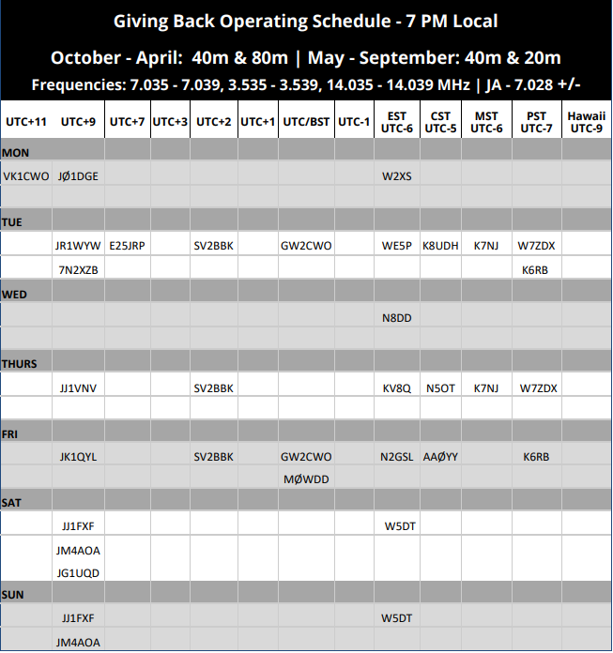
Where Can I find a Rag Chew?
Tune around an open band and answer or call CQ
Evenings on 30m, 40m and 80m
CW Ops “Giveback”
Arrange a “sked” with classmate or advisor

Slide 63
RTTY Contesting
Many CW contesters also enjoy RTTY contesting
  Fast paced, rates can approach those of CW
  Most modern rigs have soundcard built-in so easily plug-and-pray
  Bandwidth efficiency is not as efficient as CW but higher than voice
  Ops tend to naturally spread out so its not the QRM-fest typical of FTx contests
Good place to experiment with SO2R/SO2V and/or Sprinits
  Decoding is off-loaded to your computer so you can concentrate on juggling two radios
Do NOT use cut numbers
  All symbols are 5-bits
  Cap. letters, digits, punctuation and control characters are obtained by switching between two tables with 32-symbols each
  It actually takes longer to send 5NN than 599
Send <CR> and spaces before and after your messages to help separate from noise/garbage
See rttycontesting.com for more info

Slide 64
Week 4 - Session 8
Go over h/w and on air activities
On the air:
  This weekend: CQ WPX RTTY
  Next weekend: ARRL International DX CW
  Following weekend: NAQP RTTY
Chasing “rare” DX
  We are near or at the peak of the solar cycle
  Look for increased DX activity in the fall & winter, especially in the days surrounding the major International contests
No drills tonight!

Slide 65
Chasing (Rare) DX
This is quintessential ham radio and, for many, its most exciting aspect
CW is the best mode for working weak stations rapidly
  For better or worse, much DX activity has migrated to FT8
  Most major DXpeditions will include CW as part of their efforts
  Often, smaller DXpeditioners might not use CW so you need to be flexible
Your QRQ and contesting skills will serve you well!
The Internet and SDR have changed the landscape
  Instant pile-ups occur once a rare station is spotted
  A Panadapter gives you “situational awareness”
    Can do this to some extent with dual VFOs or XIT/RIT
    Radios with dual receivers are an advantage
    Consider using a WebSDR, be creative!
  Embrace it and use it to your advantage!

Slide 66
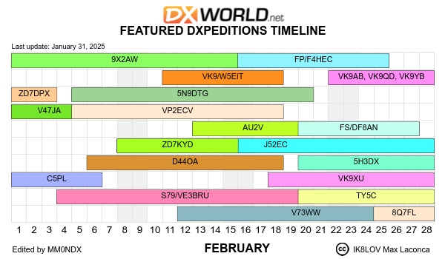
Up-coming DXpeditions

Slide 67
Chasing DX – Good Ops
Do:
  Listen Listen Listen and Listen some more !!!!!!!!!!!!!!!!!!!!!!!!!!!!
    Make sure you can hear him and verify his call!
  Figure out his timing and where he is listening – and then transmit accordingly
    Often listening UP 1-KHz or more, depending on demand
  Use full QSX (break-in) and “Split”
    Learn how to rapidly use the dual VFOs and/or XIT/RIT functions on your rig
  Be courteous and concise (TU 5NN)
  Understand Propagation and Be Patient
  Take a look at QRZ.com and/or the DXpedition website for operating plans and QSL info
  Verify that you are “in the log” via Clublog Expeditions and Live Streams

Slide 68
Chasing DX – Lids
Don’t be the lid who:
  Tunes up and/or transmits on top of the DX!!!
  Continues to operate simplex when the DX is running split (TX5S UP)
  Continues to call when the DX is clearly calling someone else
  Thinks he’s the “DX Police” (These guys are the some of the worst lids and cause more QRM than the errant simplex op!)

Slide 69
My Contact with D60AE
(Comoros) Fall 2022
Turned on radio to participate in an SST
Saw D60AE Spotted on 20m – clicked on it
He was ~539 and a large pile-up extending up ~10 KHz
Watched SDR waterfall to see who he was working and his patterns
  About 7.5 KHz up, slowly moving down
Set my rig to “split” while listening to a few more contacts
Moved my XIT down a little more, threw out my call
  After 4 or 5 tries, he came back with WW2IL
  I sent AA2IL one more time, he responded correctly
    Don’t send him your exchange until he gets you call correct
  Exchanged 5NNs and 73s
  Confirmed “In the Log” the next day on Clublog
Remember, my station is a “little pistol” - 100 W and fixed wire antennas
  ~10,500 miles distance

Slide 70
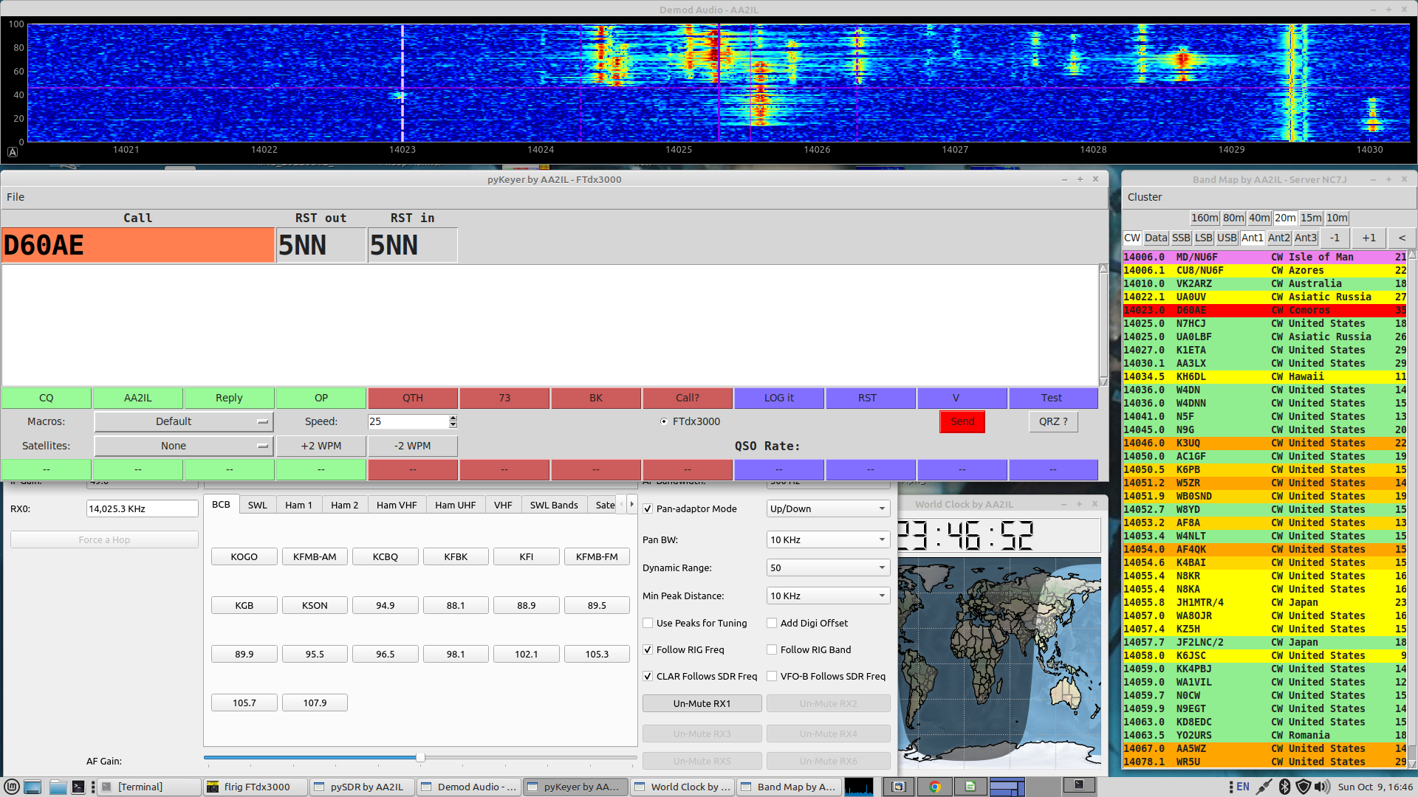
Contact with D60AE (Comoros)

Slide 71
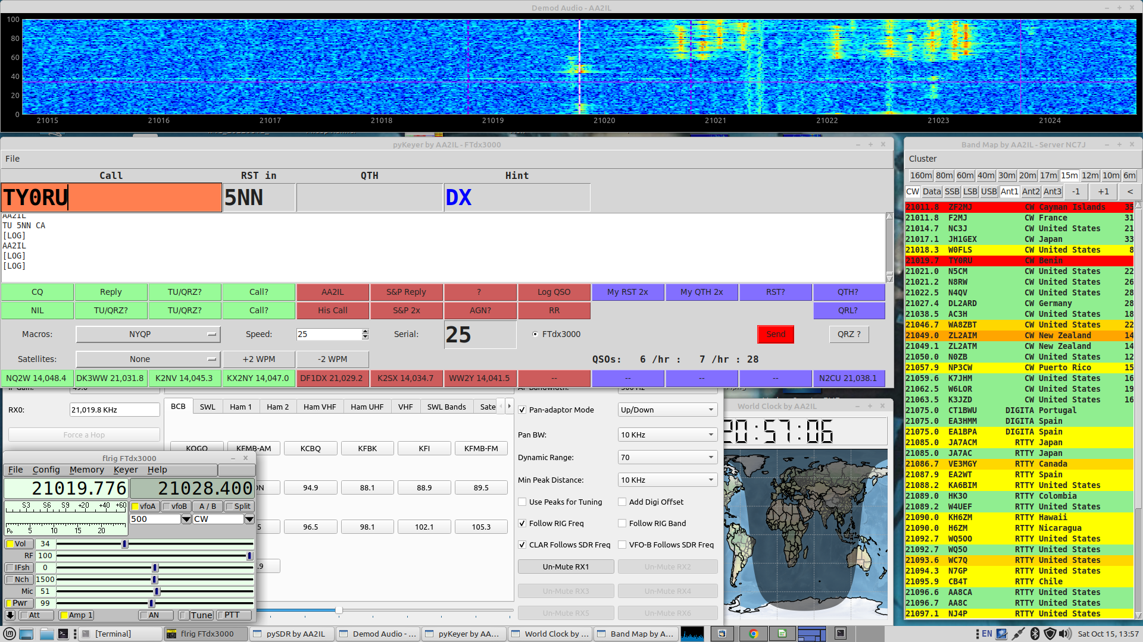
Contact with TY0RU (Benin)

Slide 72
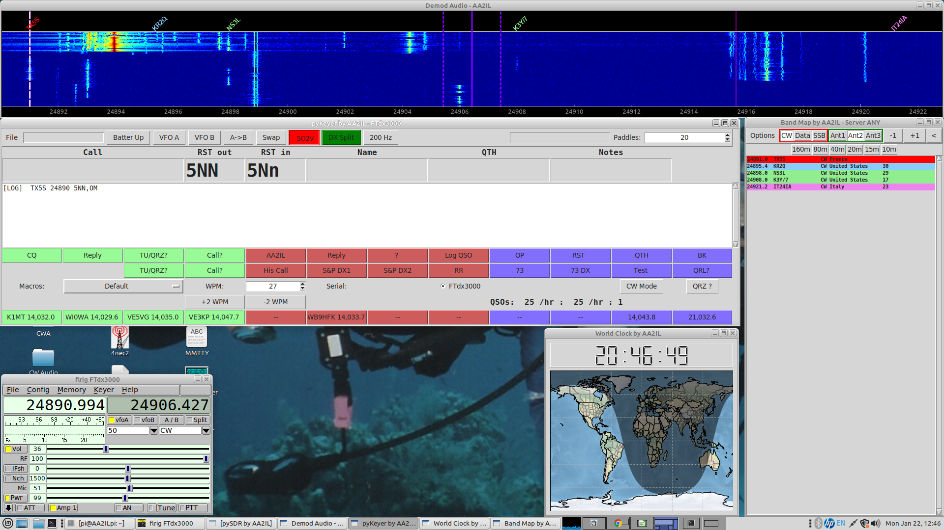
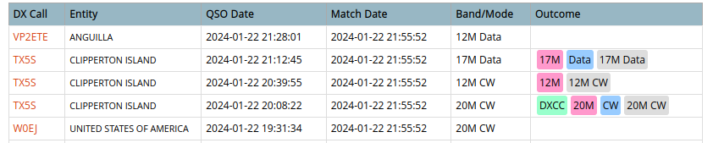
TX5X (Clipperton Isl. - 2024)

Slide 73
SDR Panadapters
Some high-end radios (e.g. IC7610) have dual receivers so you can listen to DX and the pile-up simultaneously
  Can approximate this with a single RX radio by rapidly toggling between VFOs
Many current radios have built-in panadapters
  Marginally useful at best
Some radios (e.g. FTdx300, TS590,…) have “taps” into the RF and/or IF chain brought out to the rear panel
  Easily add an SDR Dongle for under $30
Many radios (e.g. FT991, IC7300) do not any such provisions so you’ll need to add an external antenna switch also
  These can be rather expensive ($200+) but decent-quality knock-offs can be found for under $50

Slide 74
SDR Panadapter for FT991a

Slide 75
Week 5 – Session 9
Go over h/w and on air activities
On the air
  ARRL International DX CW
    The last “major” CW contest of the winter season
    There is a lot of activity leading up to this contest
    We only work stations outside of USA and Canada
    We send 5NN + State
    They send 5NN + Power
      NN = 99 Watts
      ATT = 100 Watts
      K or KW = Kilowatt ...
Computers and Logging
Round-robin questions – try not to write anything down

Slide 76
Computers and Logging
Computers are a fixture in most ham shacks now and are invaluable for contesting (and everyday operating)
  Logging & Scoring
  Keeping track of duplicates
  Sending
N1MM Logger is the most popular logging program used for contesting
  Many many helpful features
  Windoz Only
  A clone is under active development for Linux
At this point, you should be using a contest logger
  Its a good idea to let the computer do the sending for you, especially in the “fast” contests
    The other ops will appreciate the cleaner machine-generated code!
  For S&P, you can also use the memory keyer in your rig for sending (e.g. Yaesu FH-2)
  Use the “band map” to help with S&P (verify the call sign!)
Try not to use the “call history files” and “auto-fill” until you can consistently copy exchanges
  When you begin to use these features, you still need to verify that the information is correct!

Slide 77
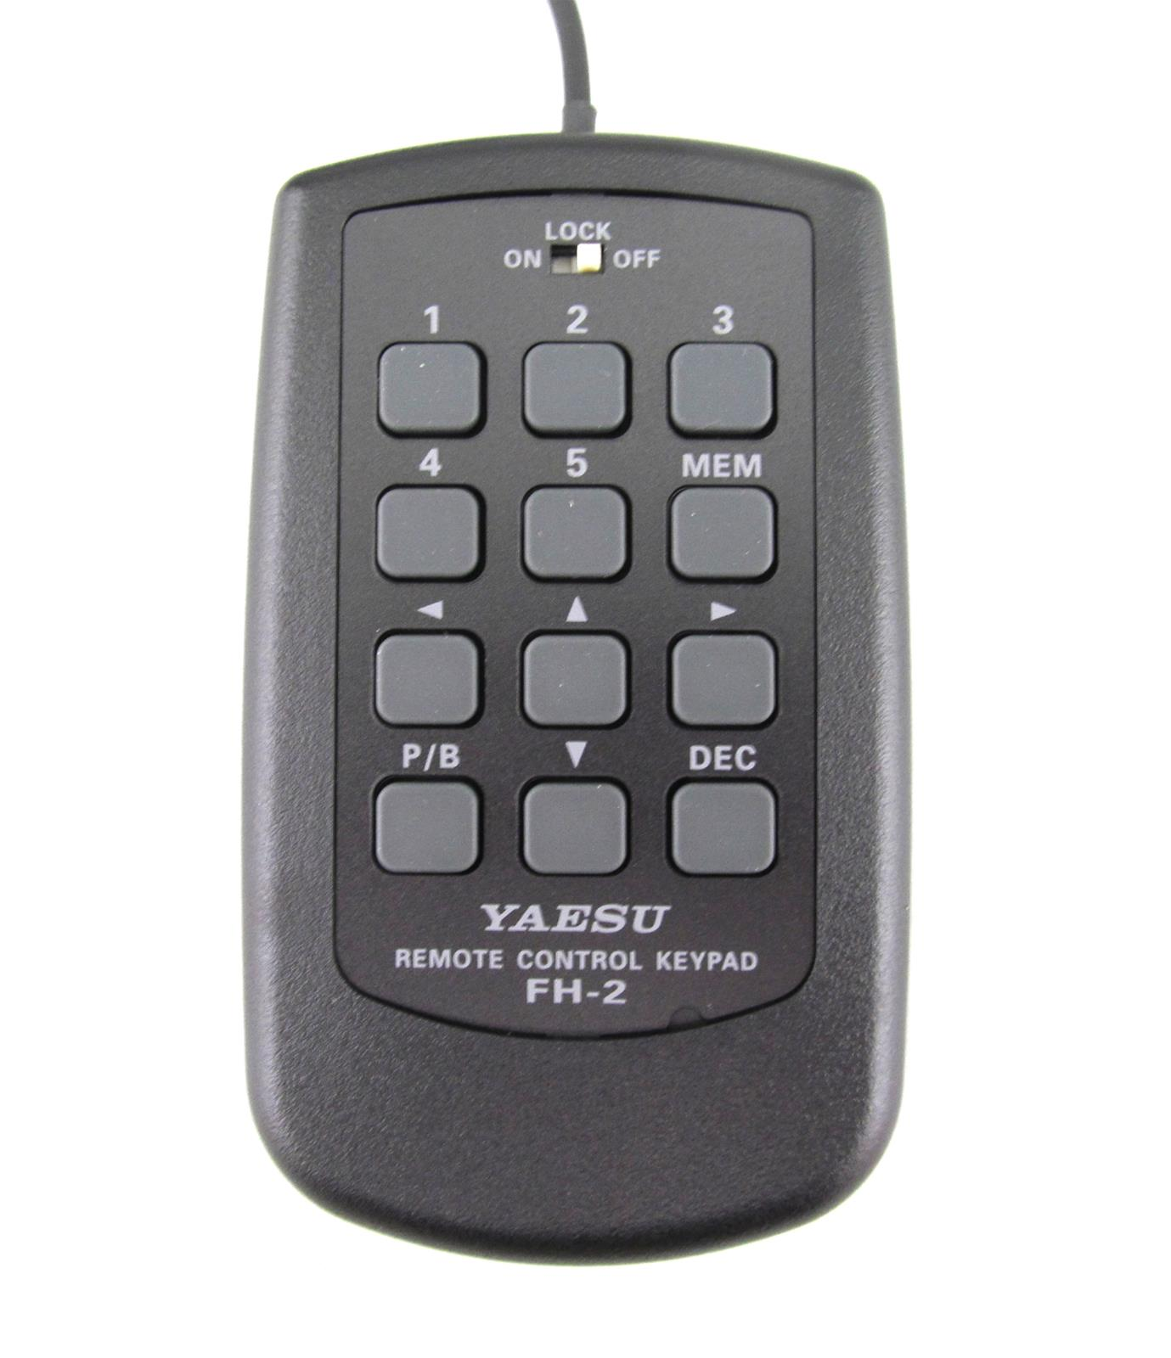
Built-in Rig Memory Keyer
Most (all?) modern rigs have a built-in memory keyer to which you can program several short messages
My “default” messages are (mainly for quick DX contacts):
  Msg 1 = AA2IL
  Msg 2 = TU 5NN CA
  Msg 3 = OP JOE
  Msg 4 = 73
  Msg 5 = BK
For S&P in ARRL Intl DX, you might use something like this:
  Msg 1 = AA2IL
  Msg 2 = TU 5NN CA
  Msg 3 = CA CA
  Msg 4 = 73
  Msg 5 = AGN? or ?
Yaesu rigs also have a serial counter so feasibly, you use this facility to S&P in almost any contest
This is NOT cheating – contesting is fatiguing and you want to employ any fair means that will maximize your Butt-In-Chair (BIC) time and therefore your enjoyment and score!!!

Slide 78
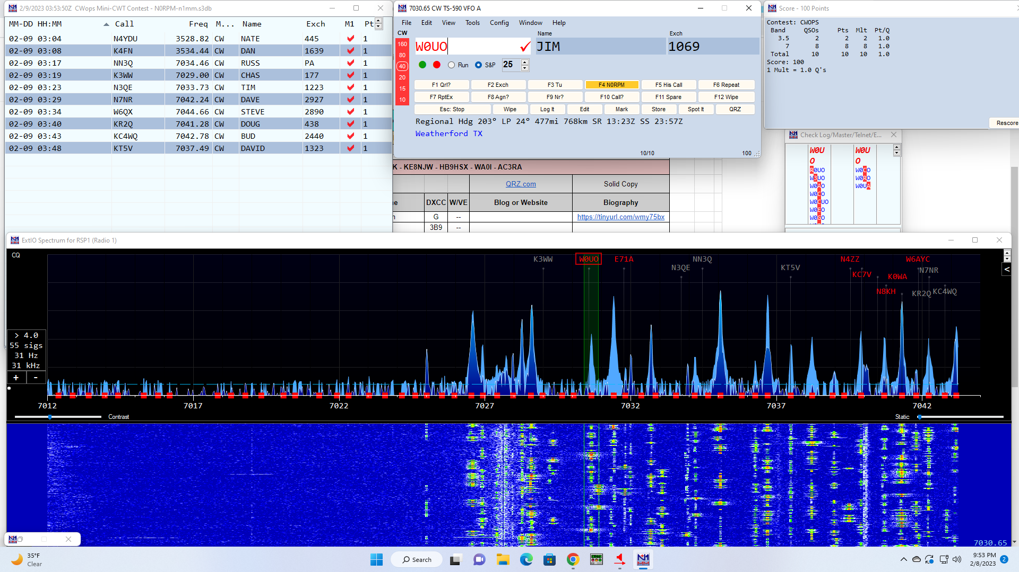
N1MM Logger
(Screenshot courtesy of N0RPM)

Slide 79
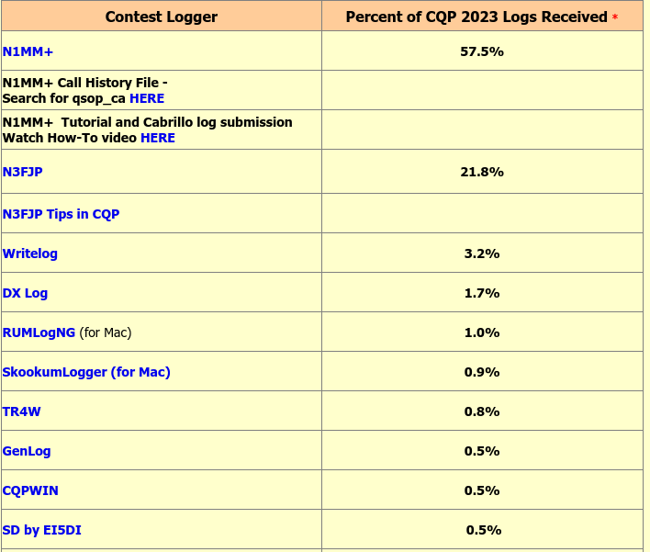
Other Loggers

Slide 80
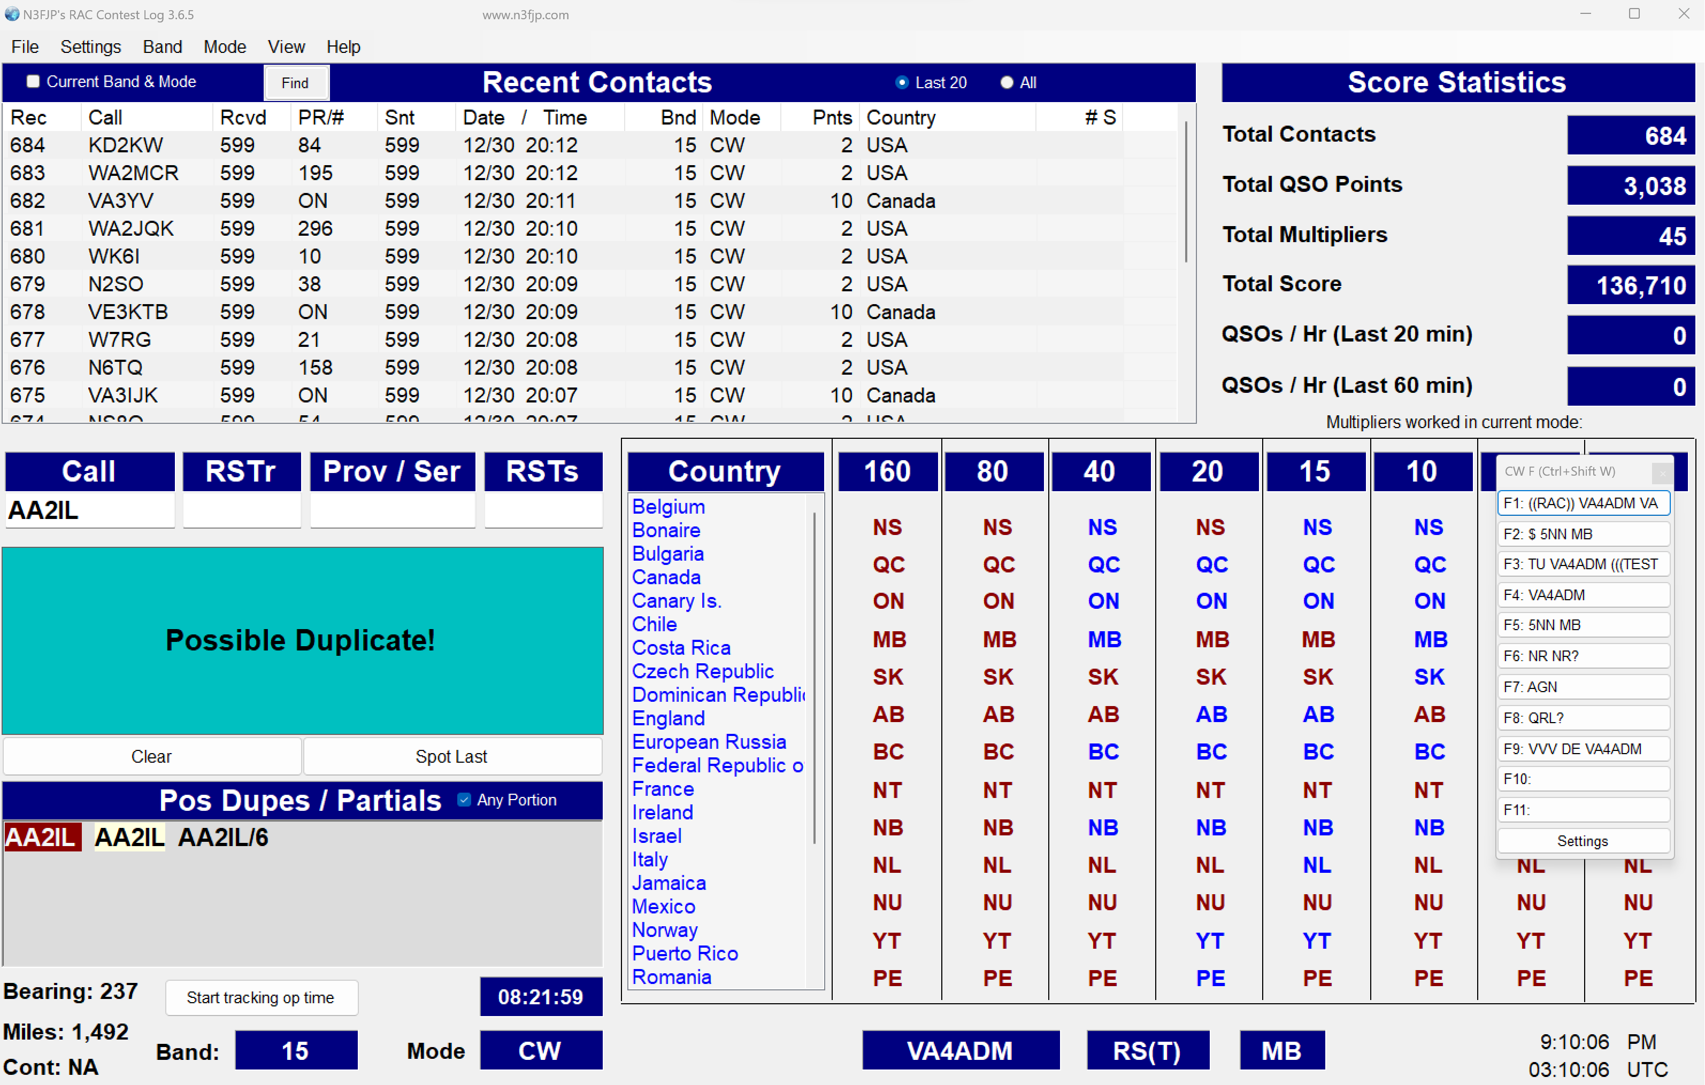
N3FJP Logger
(Screenshot courtesy of VA4ADM)

Slide 81
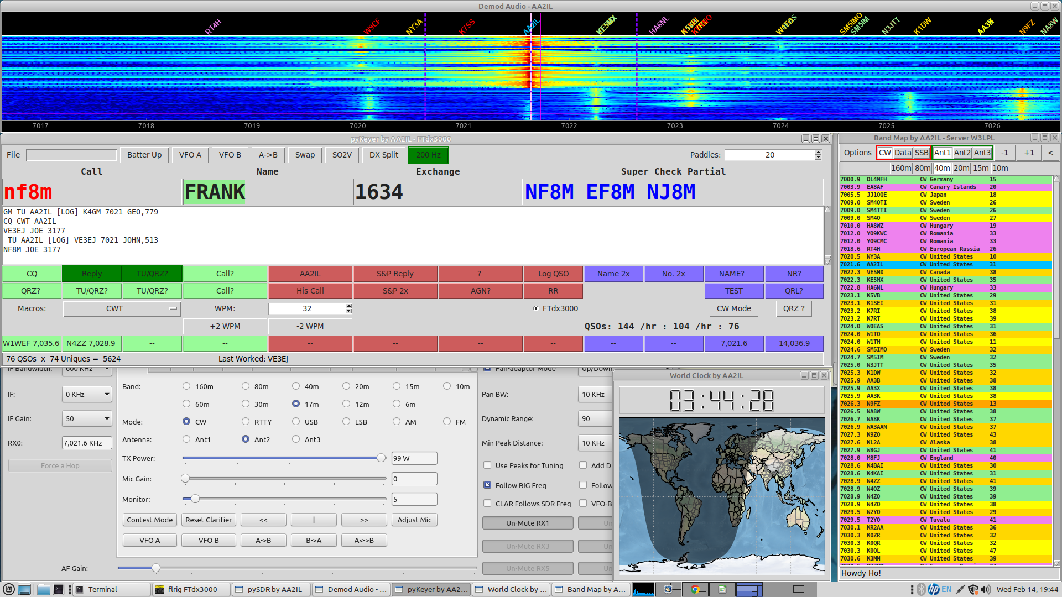
My Screen - 0300z CWT

Slide 82
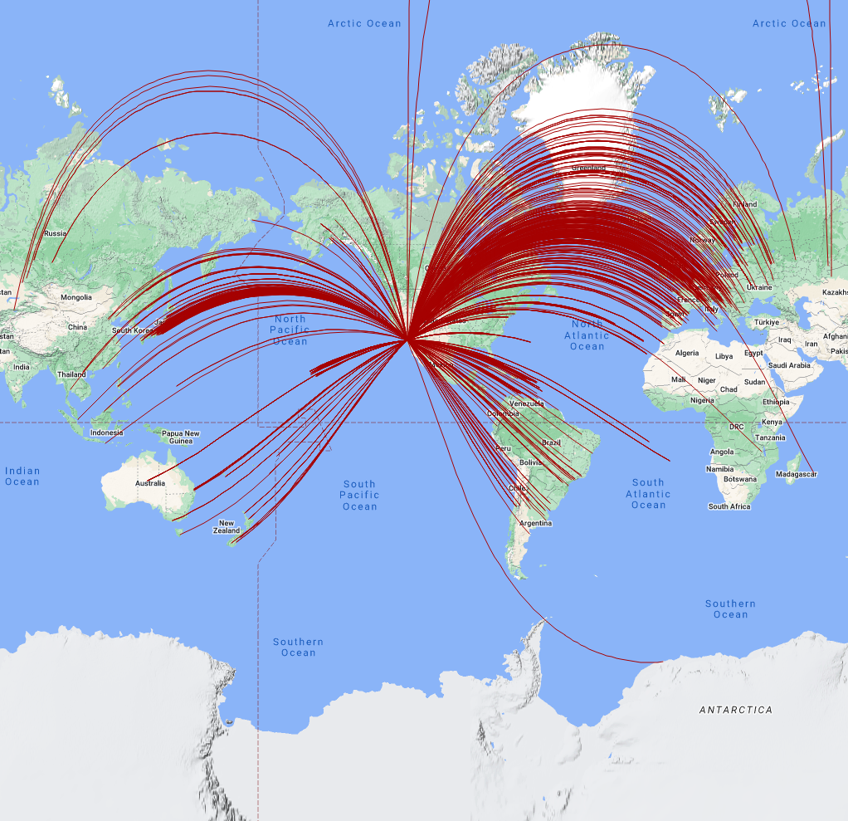
Week 5 - Session 10
Go over h/w and on air activities
This weekend is the ARRL International DX CW
  “International” → We only work stations outside of the U.S.
  We send 5NN + STATE/PROVINCE
  DX sends 5NN + Power
  The best strategy for “little pistols” is S&P for this one
  Look for plenty of DX activity before and after the contest
  Can you get DXCC in one weekend?
DX Cluster and Reverse Beacon Network
Drill: Sentences

Slide 83
My Screen - Typical CWT

Slide 84
DX Cluster
The DX Cluster refers to websites that list DX stations that other ops have “spotted”
  Rare and not so rare DX
  Running stations in a domestic contest
  dxwatch.com and dxheat.com are my “go to” sites but there are many others
Reverse Beacon Network (RBN)
  Automated systems that do this for CW and RTTY (Next Slide)
The use of these tools, even once, puts you in the “assisted” category in a contest
  S&P: Quickly identify un-worked stations and “multipliers”
  RUNNING: Quickly identify open frequencies
These tools have altered the landscape for chasing DX
  No longer have to endlessly “spin the big knob” to find DX
  Generates instant pile-ups

Slide 85
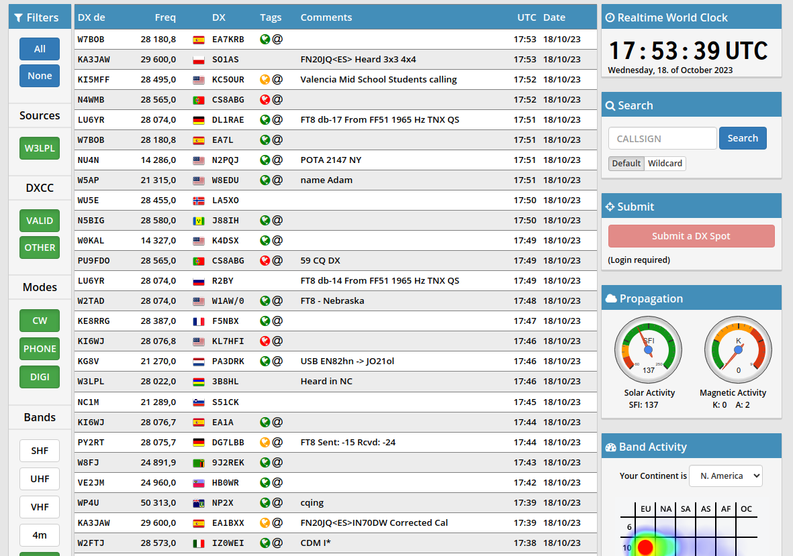
DXHeat.com
Ops Manually Enter “Spots”

Slide 86
Week 6 - Session 11
Go over h/w and on air activities
On the air:
  SC and NC State QSO Parties
  NAQP RTTY
Preliminary results from Jan. NAQP CW have been posted https://ncjweb.com/current-naqp-cw-results/
February Solid Copy is available at https://cwops.org/newsletter-current/
Reverse Beacon Network (cont.)
Round Robin Q&A

Slide 87
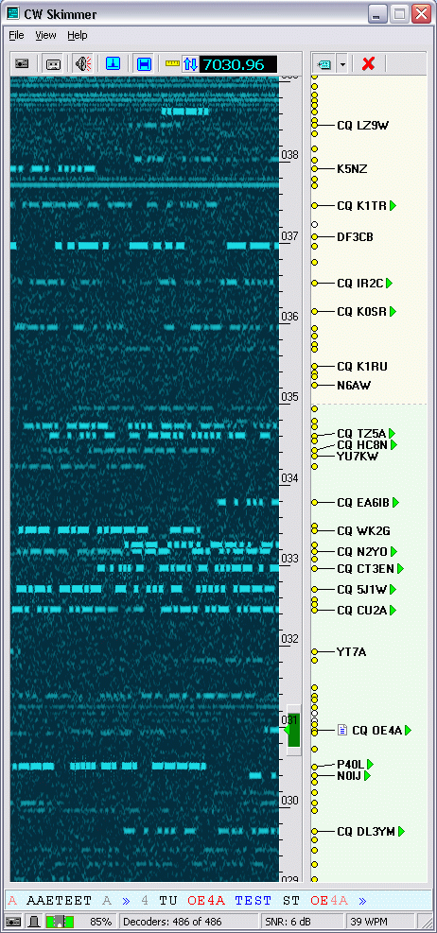
Reverse Beacon Network (RBN)
A world-wide system of SDRs monitoring one or more bands and using automatic decoders
  CW and RTTY “Skimmers”
You can view data “live” or download and analyze historical data off-line
  This is an excellent tool for assessing your station’s performance
  Send CQ <YOUR_CALL> or TEST <YOUR_CALL> a few times to get spotted
reversebeacon.net – can also get raw RBN spots in real-time
  PSK Reporter does something similar for FT4/8 signals → Almost everyone is a spotter/monitor!
Competitive Contest Loggers have the ability to import spots from a cluster node
  From cluster or RBN or both
  Can usually “filter” the spots you actually see

Slide 88
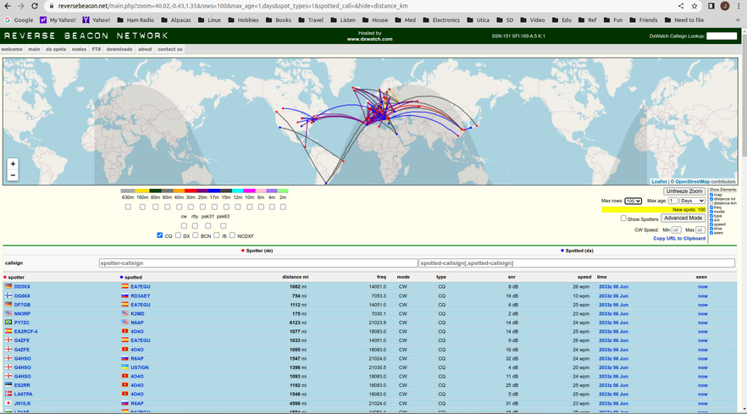
Reverse Beacon Network (RBN)
Spots Automagically Generated by Skimmers

Slide 89
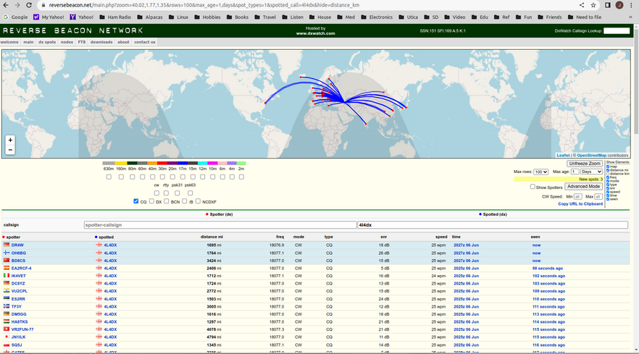
RBN Real-Time Filters

Slide 90
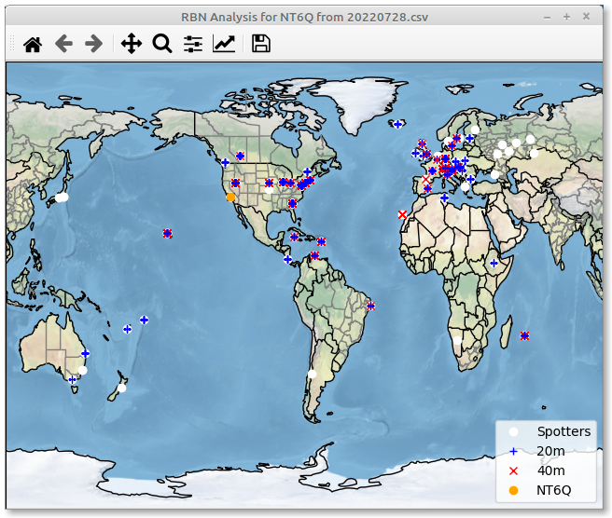
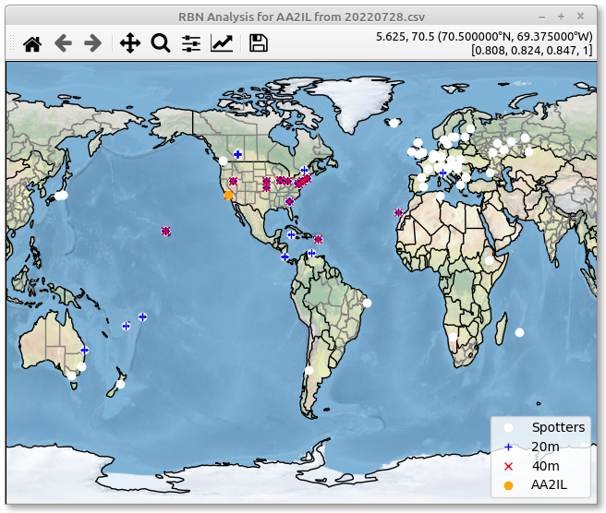
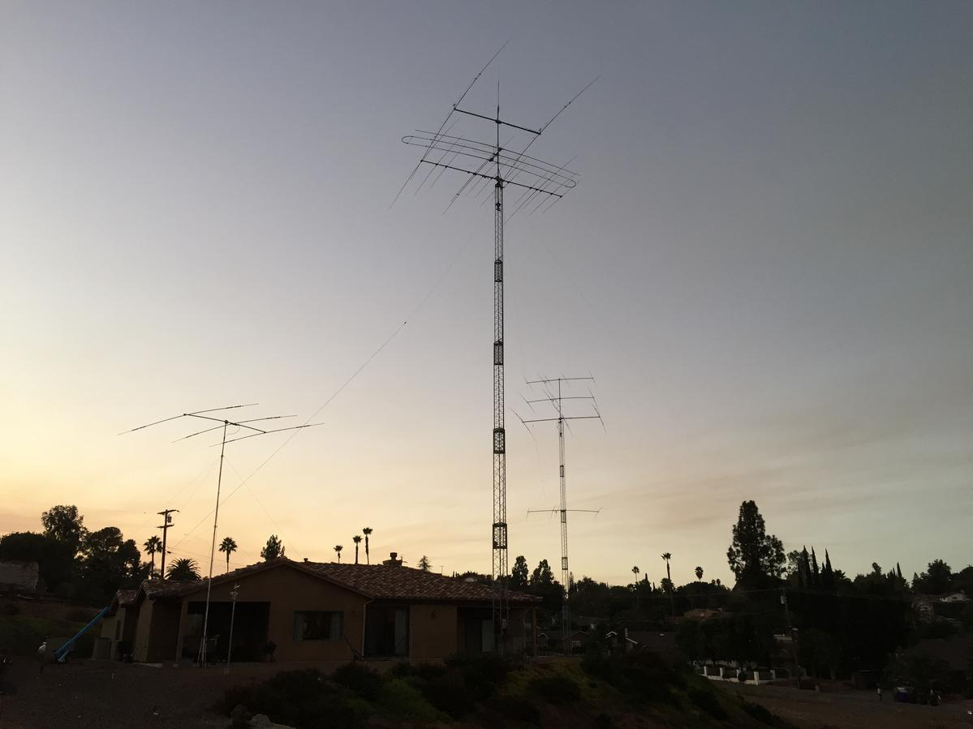
Big Gun vs Little Pistol
CWT 0300-0400 July 28, 2022
NT6Q
AA2IL

Slide 91
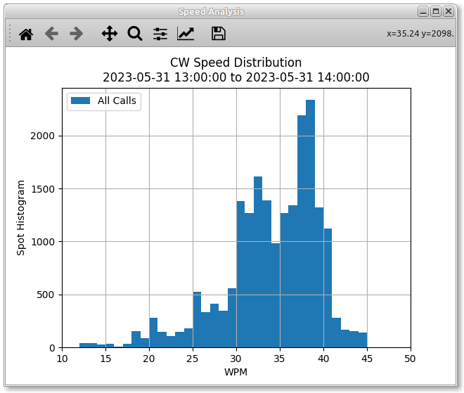
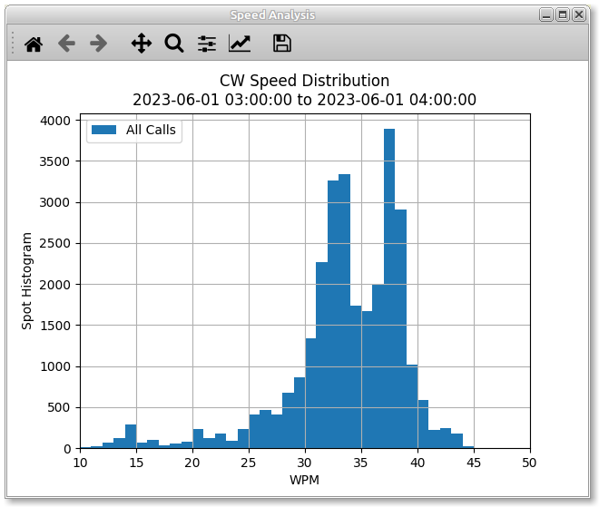
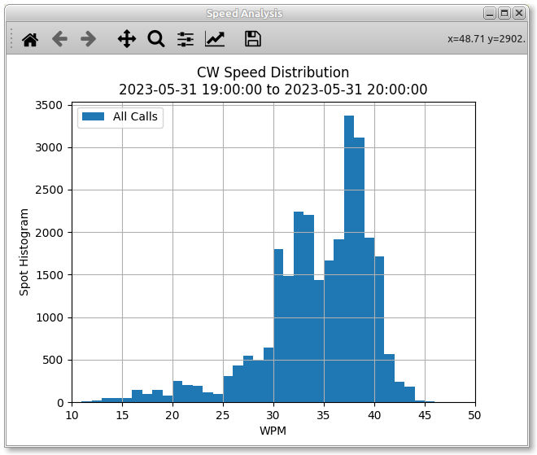
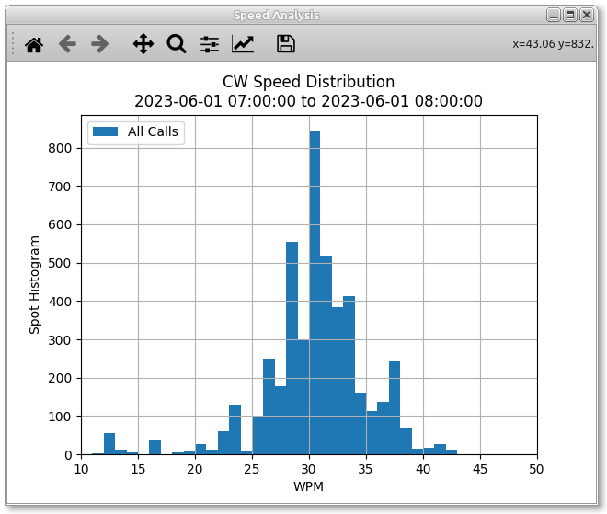
Speed Analysis – May 31, 2023 CWTs
1300Z
0300Z
Mean=33.6
Mode=38
Mean=33.6
Mode=38
Mean=33.2
Mode=37
Mean=33.2
Mode=37
1900Z
0700Z
Mean=30.0
Mode=30
Mean=33.9
Mode=37

Slide 92
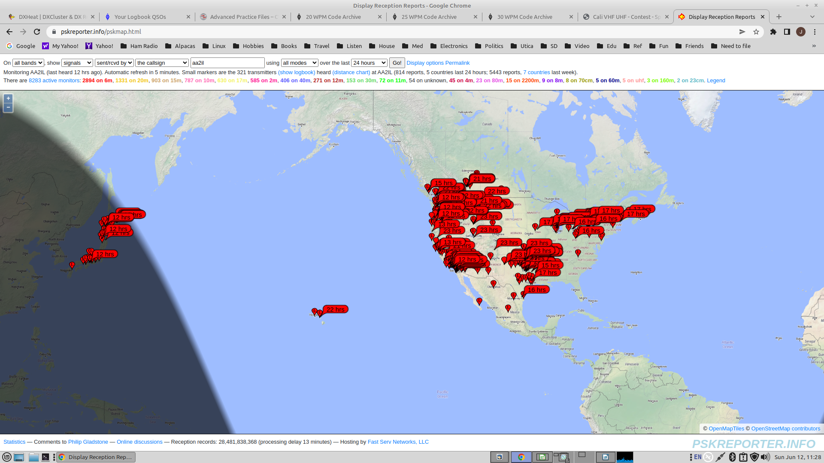
PSK Reporter – Stations Who Heard Me on 6m During the June 2022 VHF Contest

Slide 93
Setting Up Your Own
Monitoring Station
CW and RTTY skimmers are available at same place you found Morse Runner
  30-day Free Trial
  Can use regular WSJT-X for FTx (free)
An RTL Dongle allows you to monitor a single band
  160m and 80m are close enough to monitor simlutaneously
I’ve used an SDRPlay RSP-1 to monitor up to 3-bands simultaneously
“Wideband” SDRs (e.g. Red Pitaya) can monitor the entire HF-spectrum simultaneously
To post spots to the RBN, also need “Aggregator”

Slide 94
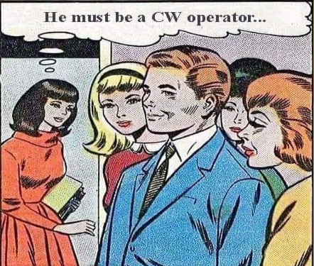
Week 6 - Session 12
A Big THANK YOU to Marty, N7AAE, for skimmer and logger demonstration last time
Go over h/w and on air activities
On the air:
  SC and NC State QPs
  NAQP RTTY
A Comment on Speed
After the contest
English Idiom Exercise

Slide 95
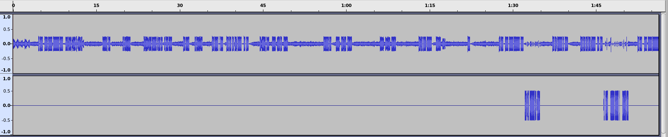
Fast is NOT Always Faster
TU WJ0W
N4EEB
KB1EFS
N4EEB
N4EEB
N4EEB 599 LN FL
599 LN FL
NAME
R
TU WJ0W
AA2IL
RANDY ND
TU WJ0W
KB1EFS
N4EEB
N4EEB
N4
N4EB RANDY ND
AGN
599 LN FL
LN
AA2IL
TU JOE CA
Audio Clip is from Jan. 2023 NAQP – PSE_QRS.mp3
Running OP is clearly struggling (major kudos for putting ND on the air!)
Persistent Pouncer with a somewhat difficult call and name only finally slows down after several repeats
  Other pouncer gave up and moved on
  “LN” is probably a shortened version of “ELLEN” but just doesn’t work in this context (IMHO)
Runner never gets call correct so won’t get credit for QSO
I was able to complete a contact quickly with no repeats simply by tapping on the brakes

Slide 96
After the Big Event
Take a deep breath
Write some quick notes on what was good and what to do different/better next time
  Review and follow-up:
    After scores have been posted (get LCR if possible)
    Before next contest and/or next run of same contest
Submit summary to 3830scores
Upload ADIF log to Clublog and LoTW
Submit CABRILLO log to contest sponsor

Slide 97
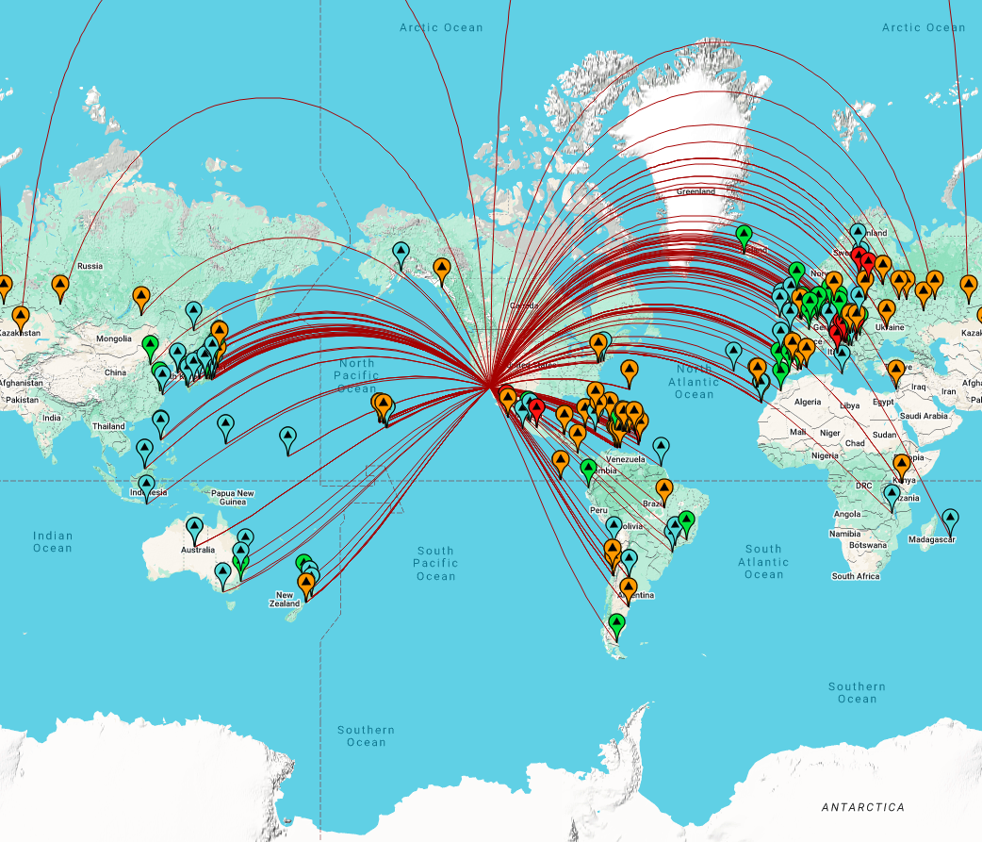
  How Cool is this?! tools.adventureradio.de/analyzer

Slide 98
English Idiom Exercise
Some English Idioms:
  The Check is in the Mail
  The Ball is in Your Court
  A Blessing in Disguise
Round-Robin Drill
  First Op sends an idiom
  Second Op repeats
    Get confirmation from First Op
  Rinse and repeat
  Head-copy Only!

Slide 99
Week 7 - Session 13
Go over h/w and on air activities
ARRL International DX SSB is this weekend
  Very popular, good luck to AK4R and his friends at PJ2T!
  Look for increased DX activity surrounding the contest
  Its often easier to chase CW DX during a major phone (or digi) contest
We have two weeks left – Are there any topics you want to explore?
  Log Check reports (Thursday)
  CWops Club (Next Monday)
  Graduation/Feedback (Next Thursday)
Comments on RufzXP and MorseRunner
Drill: Story Time

Slide 100
Are You Bored with
MR and RufzXP?
MorseRunner and RufzXP are fantastic practice tools BUT ...
They are a means to an end (Improving your abilities OTA), not an end in themselves
  It can become addicting to beat your best score but ...
  Its even more fun to run in a contest and/or beat your best score
Both tools emphasize rapid ICR and touch typing what you hear
  Obvious advantages for Contesting, Chasing DX and similar activities like POTA/SOTA, Field Day with your local club, ...
There are also advantages if you are primarily a rag chewer:
  ICR will also help you improve your head copy speed
  Morse Runner gets you used to copying high-speed code in typical conditions
    Low SNR (QRN)
    Interference (QRM)
    Fading (QSB)
    ...

Slide 101
Plateauing with RufzXP?
RufzXP should always be challenging since it automatically increases the sending speed the more successful you are
If your scores seem to be plateauing, increase your starting speed and/or try not to ask for repeats
  I don’t worry too much about the actual score but pay much more attention to the speed at which I “top out”
At some point, you will have trouble distinguishing between similar characters (e.g. I vs S vs H vs 5, V vs 4, B vs 6, etc.)
You will have to have some knowledge of valid international call signs to deal with this
  S62ABC is not a likely ham call but HB2ABC is
  H5HY is not valid but S55Y is
What happens if you manage to exceed 50-WPM?

Slide 102
Plateauing with
Morse Runner
MR and MR CE are very realistic simulations of what you will see in an actual contest
If you are plateauing with this training tool:
  Increase sending speed
  Turn on more channel effects (QRM, QSB)
  Increase “activity level”
  Try running in an actual contest (e.g. SST, MST, CWT)
One of the most difficult skills to develop is how to work through a pile-up of nearly zero-beat callers
  Hopefully, one of the callers is louder or more persistent or slightly tuned off from the rest
  If not, try grabbing a partial call to help “thin the herd”
  Some callers still won’t honor your request so you might have work them to get them out of the way
  You need to become efficient at working through a small pile-up as the “un-chosen” will quickly look elsewhere
If you are looking for another challenge, get a taste of what a DXpeditioner faces via PileUp Runner.

Slide 103
Story Time Exercise
You guys have been outstanding with all of the drills we’ve done so far!
Let’s try telling a story:
  OP1: I have a large white dog
  OP2: I have a large white dog
  She guards my animals
  OP3: She guards my animals
  She also likes to hunt rabbits
  OP4: She also likes to hunt rabbits
  I can tell when she ate a rabbit because her breath really stinks
  OP1: etc. etc. …
Usual round-robin approach
  Send call of op you are sending to
  Repeat sentence from previous op

Slide 104
Week 7 - Session 14
Go over h/w and on air activities
ARRL International DX SSB is this weekend
  Very popular, good luck to AK4R and his friends at PJ2T!
  Look for increased DX activity surrounding the contest
  Its often easier to chase CW DX during a major phone (or digi) contest
We have two weeks left – Are there any topics you want to explore?
  Log Check reports (Thursday)
  CWops Club (Next Monday)
  Graduation/Feedback (Next Thursday)
Log Check Reports
Drill: Story Time

Slide 105
Week 7 - Session 14
Postponed
  Class will still have 16-sessions

Slide 106
Week 8 - Session 14
Go over h/w and on air activities
This weekend OTA:
  OK, ID and WI State QPs
  Stew Perry 160m contest
We have three sessions left – Are there any topics you want to explore?
  Log Check Reports and/or Muley Map (Tonight)
  CWops Club (Thursday)
  Graduation/Feedback (Next Monday)
Daylight Savings Time starts this weekend
  Suggest we keep last meeting time at 6PM PDT
Log Check Reports
Drill: Story Time

Slide 107
Left Overs – Yum!
Last Monday, we had the pleasure of another discussion about SDRs and Skimmers, etc.
Please review comments about MR and RufzXP
  There are ways to make these practice tools more challenging
One of the most difficult skills to develop is how to work through a pile-up of nearly zero-beat callers
  Hopefully, one of the callers is louder or more persistent or slightly tuned off from the rest
  If not, try grabbing a partial call to help “thin the herd” K7? NX?
  Some callers still won’t honor your request so you might have work them to get them out of the way
  You need to become efficient at working through a small pile-up as the “un-chosen” will quickly look elsewhere

Slide 108
Accuracy is Important!
Your score is generally the product of the number of QSOs and the number of “multipliers” (one or both may be weighted)
  To get credit for a QSO, you must copy the call sign and exchange correctly
  Your score tends to increase quadratically the longer you operate but ...
  Errors tend to reduce your score quadratically as well
Scoring for ARRL contests is particularly brutal as there is usually an additional penalty for each busted call sign
  Not in Log (NIL)
  Incorrectly copied/logged
The winners of many large contests are often determined by which ops make fewer mistakes
  Goal: “Aim for a “Golden Log”
This is not as much of a concern in the practice contests (SST/MST/CWT) since they are not adjudicated BUT …
How you practice will likely be reflected in your performance in an actual contest

Slide 109
IARU HF Log Check Report
2022 IARU HF CHAMPIONSHIP AA2IL
There were 404 calls found.
Your full callsign is = AA2IL
Your ITU zone was 6
CALLSIGN CHECK RESULTS
----------------------
40CW JI1RFN is a busted call. The correct call is JI1RFB.
You had 1 calls in your log which were not found in the database of good
callsigns. All of these were judged to be busted calls and will be removed
from your score - along with an additional penalty of one QSO per busted
Callsign.
EXCHANGE CHECK RESULTS
----------------------
40CW K2ZW : 8 should be 6
100.0% of your non dupe QSOs had their exchanges checked.
There was only one exchange error found. This QSO will be removed from your
your score with no penalty.
Easy exchange: 5NN ZONE
Call sign and/or call history give big clues as to ITU Zone
QSB?
Probably didn’t correct pre-fill from call history

Slide 110
IARU HF LCR (cont.)
CROSS CHECK RESULTS
-------------------
15CW K4ZW QSO not found in log.
87.8% of your remaining good QSOs were cross checked.
There was one bad cross check QSO removed.
You had one not-in-log which will be deducted from your score.
There is an additional penalty of one QSO for every not-in-log.
DUPE CHECK RESULTS
------------------
KA0PQW is a dupe on 40CW at line # 403
There were 404 QSOs checked for dupes.
There was one dupe found. It was removed with no penalty.
Error rate = 0.7% (100 X (Busted QSOs / Duped QSO total))
Can’t control what other guy does
Easy exchange --> fewer mistakes!

Slide 111
Week 8 - Session 15
Go over h/w and on air activities
This weekend OTA:
  OK, ID and WI State QPs
  Stew Perry 160m contest
We have two sessions left – Are there any topics you want to explore?
  CWops Club (Tonight)
  Graduation – Muley Map and Feedback (Monday, TIME CHANGE: 0100 UTC = 6PM PDT)
CWops Club
Drill: Dear Diary

Slide 112
And Now a Word From
Our Sponsor ...
CWops is an international club to promote the art and use of CW on the amateur bands
  Rag Chewing
  Competitive Events/Contesting
  DX/Awards Chasing
Created approximately 15-years ago, current active membership is ~3,000
It is NOT contesting club, nor a “Top Operators” Club
The 25-WPM threshold and sponsorship criteria are designed to attract operators who have a serious commitment to CW

Slide 113
CWops is an Activities
Oriented Club
CW Academy
  Please consider becoming a Advisor or Co-Advisor!
CWTs – Four one-hour sessions each week
CW Open – Annually in September – GO BRASS FLOUNDERS!
Give Back – Conversational Practice most evenings
QTX - Rag Chewers
Awards: CWT Participation, ACA, CMA, WAS, DXCC, WAE, WAZ ...
  Upload your logs to https://cwops.telegraphy.de/
  Post CWT summaries to https://3830scores.com/
Solid Copy - Monthly Newsletter
E-mail Reflector

Slide 114
CWops Membership
Requirements
Demonstrate Proficiency at 25-WPM or higher
  Easiest way is to make several contacts in the CWTs
  You can also schedule contacts with current members to gain sponsorship (or call/answer CQ or have a give-back QSO or ...)
Nomination + 3-sponsors
  Solicitation of sponsors is perfectly acceptable!
You don’t need to be perfect!
  Implicit is the understanding that you will continue to improve as you get more involved with the club activities
Dues: $15/yr or $60 for 5-years or $125 for life

Slide 115

Session 16 – Graduation!!
Certificates
Major CW contests throughout the year:
  NAQP – January and August
  ARRL International DX CW – February
  CQ WPX CW – May
  ARRL Field Day - June
  IARU HF Championships – July
  CWops CW Open – September
  California QSO Party - October
  ARRL Sweepstakes - November
  CQ WW CW – November
  State QPs - February – November
  ARRL 10m and RAC Winter QP – December
Final slide deck for class is available at https://github.com/aa2il/CWA/blob/master/0-CWA_Notes.pdf

Slide 116
My Favorite Ham Websites
Contesting related:
  WA7BNM’s Contest Calendar: contestcalendar.com
  WA7BNM’s Contest Score Rumors: 3830scores.com
DX Cluster:
  DX Heat: www.dx-world.net
  DX Watch: dxwatch.com
Activity:
  Reverse Beacon Network: reversebeacon.net
  PSK Reporter: pskreporter.info
Chasing DX:
  DX World: dx-world.net
  DX News dxnews.com
Propagation:
  VOCAP voacap.com
  DX View hf.dxview.org
Just Plain Cool:
  ADIF to MAP: analyzer.adventureradio.de
There are many other very good sites

Slide 117
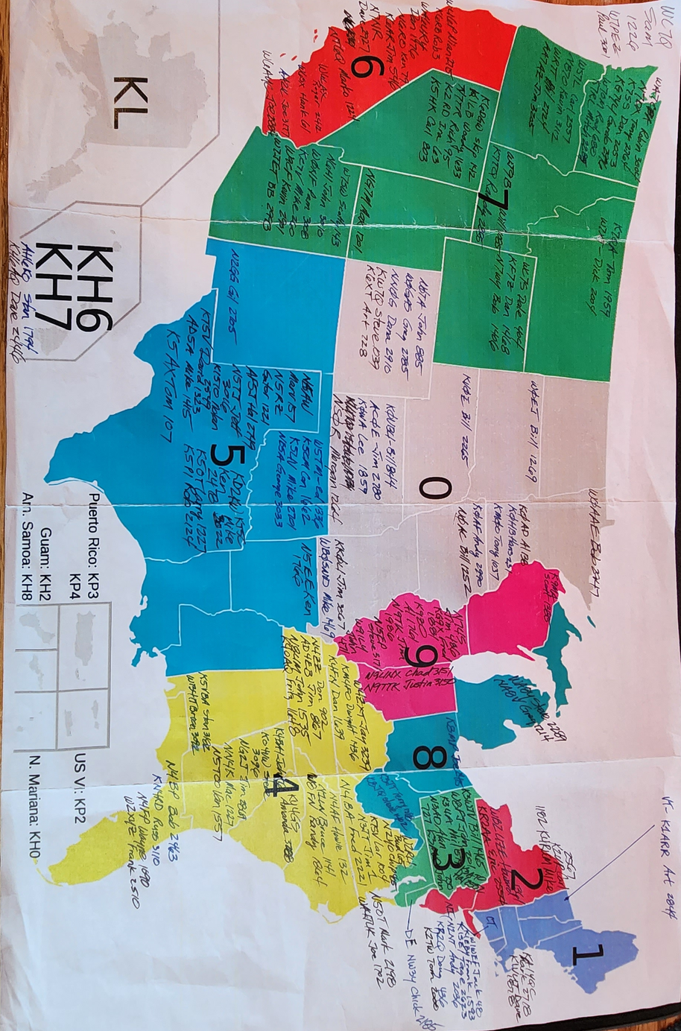
The Muley Map

Slide 118
Final Comments
It has been a genuine pleasure working with each of you
  You each have made significant progress
  There is an optional self-evaluation on the CWops website
Please keep in touch
Keep on practicing
Get on the air!
Please provide feedback to us on this class:
  Overall format (too much talk, not enough practice?)
  Topics you would have like to see
  Topics that we should have skipped ...
If any of you are linux hackers and are interested, I’d like some collaborators on the operating tools I showed you

Slide 119
Feedback From Class #6
Need to have some “structured/driven” sending practice
  We do a lot of receiving practice
  Not big fans of iambic master
  Need to get paddling.py distributed?
Organization of CWops website
  Would be better if mp3 files were organized by week and session number
  Perhaps I can put together a cheesy website that does this?
How do we route audio directly to computer instead of listening to sidetone captured by microphone
  Some have echos
  Some can’t hear what they are sending very well
The guys would be very interested in OTA auxilary sessions

Slide 120
Additional Material
More Contesting Info
Sending
Morse Code Timing
A simple iambic keyer/code practice oscillator
FT8
My station and software

Slide 121
More Contest DOs and DON’Ts
Before the contest:
  Become familiar with the rules (who to work, exchange, scoring, multipliers, log submission deadline)
  Update and test computer OS and logging software (Also test your rig and antennas)
  Take a look at the NCJ for hints from top-tier contesters
After the contest:
  Upload your summary to 3830scores.com
    Track your progress
    Get more visibility for your call sign
    Credits toward club awards
  Upload your log to LoTW and Clublog
    The final courtesy of a QSO is a confirmation (QSL)
  Submit your log to the contest sponsor
    Helps with log checking
    Many sponsors will provide you a log-check report so you can see how accurate you are
During the contest:
  Don’t send “B4” to a Dupe
    Just work him again - Its almost always faster
    He may not have you correctly in his log
    He may be using an old-school paper log
  Call your CWA advisors/classmates/friends for extra brownie points!!!

Slide 122
What If You Miss Something?
Occasionally, you will miss a call sign or part of an exchange:
  QSB, QRM, QRN, Poor Fist, Fatigue …
If you are running, you must ask for a repeat if you have any doubts:
  Call sign: N0? or PM? or 0? or CALL? or ? or “the pregnant pause”
  Serial: NR?
  Name: Name?
  QTH: QTH?
  Entire Call or Exchange: ? or AGN?
If you are S&Ping, use your discretion whether to ask for a repeat or just listen to the next QSO
  How competitive are you?
  How busy is the runner?
  Try not to slow the runner or next caller down
  Don’t ask for his call sign unless he hasn’t ID’sed in sevesral QSOs
  Be careful with serial numbers – they are not always consectutive!
In either case, try to be specific what you need
Perfection is not necessary in an un-scored practice contest but don’t get lazy!

Slide 123
Scoring & Classifications
YOUR SCORE = QSO POINTS x MULTIPLIERS
Unassisted – No spotting assistance or multi-signal decoder
Assisted – Use of Spotting Assistance
  DX Cluster, Reverse Beacon Network, CW Skimmer, WSJT-X ...
QRP – 5-Watts or less
Low Power – 100-Watts or less
High Power – Over 100-Watts
Single Op, Multi-op, ...

Slide 124
ARRL Field Day
Fourth Weekend in June
One of the most popular operating event all years
  “Its not a contest” – Logs are not adjudicated
  RAC Section list as been updated (and a few other rule changes)
Exchange:
  No. TRANSMITTERS, CLASS and SECTION
    CQ FD AA2IL
                N7AUE
    N7AUE TU 2E SDG
                TU 1B NV
    73 AA2IL

Slide 125
Sprint Contests
The QSY requirements make these events quite different compared to a typical contest:
  If you call CQ, you must QSY at least 5-KHz before you can call CQ again
  If you pounce, you can answer one caller and then you must QSY
The order of the elements in the exchange indicates who is the CQer and who is the pouncer:
  CQ NA AA2IL
  N7AUE
  N7AUE AA2IL 123 JOE CA
  AA2IL 456 JIM NV N7AUE
  TU
  W0WL
  W0WL N7AUE 457 JIM NV
  N7AUE 789 JOE WA W0WL
  TU
See https://www.kkn.net/n6tr/sprint.html for an in depth look

Slide 126
QTCs
Some European contests include “QTCs” which add another level of difficulty to the exchange
  A QTC is info from a previous contact you had in the contest
  True test of skill since nearly impossible to predict
Example (Time Call Number)
    CQ TEST SV2HUD
                NJ7V
    NJ7V TU 5NN 123
    TU 5NN 456
    R QTC?
                R 1608 KM6GOX 455
    R ...
YL3JD’s QTC Trainer: https://yl3jd.fizioikskile.lv/qtc/
YL3JD’s Contest Trainer: https://yl3jd.fizioikskile.lv/fsm/

Slide 127
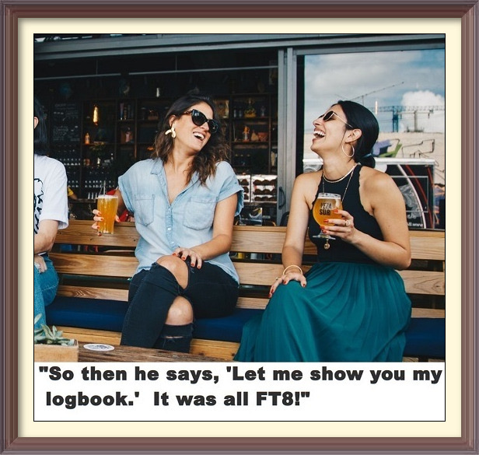

The Elephant in the Room

Slide 128
What about FT8?
There is no question that FT8 is by far the most popular mode in use these days
  Nearly all DXpeditions include a significant FT8 component in their operating plan
There is also no denying that this mode stirs up some very heated comments amongst CW devotees.
On the plus side:
  The use of error control coding introduces redundancy that improves performance compared to RTTY
  In an age of ever increasing restrictions (e.g. HOAs) and RF noise, it offers many ops an opportunity for many to still enjoy our great hobby
  It can provide a gateway to newcomers (who we hope will eventually become bored with FT8 and endeavor to learn CW!)
  It is possible to enjoy being on the air while doing something else
  There’s always a party to be found on somewhere!

Slide 129
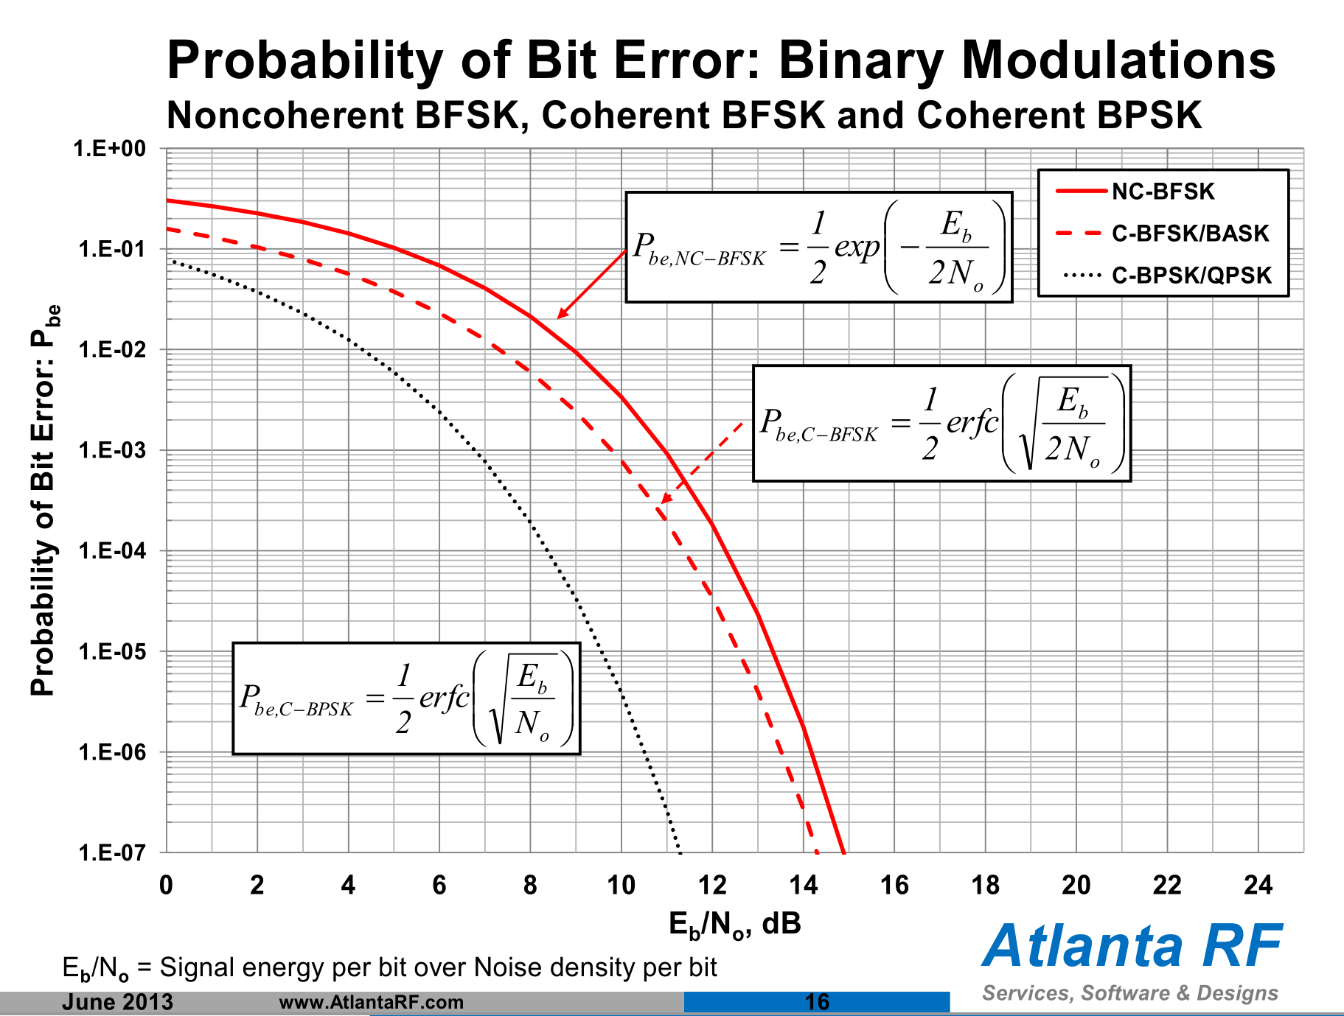
FT8 – The Rest of the Story
Major Objections include:
  The existence of “robot” variants of WSJT-X that don’t require any human intervention – not as prevalent as it is made out to be
  Lack of a conversational capability - JS8CALL is not very popular
  Dependency on an accurate clock – easy to overcome using a cell-phone or GPS dongle
IMHO, the WSJT software and operating technique have not kept up with the explosive popularity of this mode
  Confining a large number of ops into a single voice channel with no standard method to “spread out” results in a “QRM-fest”
Its sensitivity/capabilities are greatly exaggerated:
  Referencing the SNR of a signal that only occupies a few Hz of bandwidth to 2.5KHz is questionable:
    SNRft8 = S / N = [Eb R] / [No Bref] = Eb/No R/Bref
    Eb = Average Energy per Information bit
    No = Noise Power Spectral Density (assumed white)
    R = Information data rate = ~77-bits/15-sec.
    R/Bref = (77/15)/2500 ~ -27 dB
    Eb/No = SNRft8 + 27dB is the standard measure of SNR when evaluating the performance of a digital comm schemes
  The myth that FT8 somehow magically digs signals out from well beneath the noise floor and is therefore much more sensitive compared to other modes, including CW, is simply NOT TRUE!
The F/H mode is confusing and of dubious value since it reduces the fox’s signal by 6-dB each time he doubles the number of streams
  Burying this option in an obscure menu doesn’t help – turns out “hounds” don’t need it if they stay above 1-KHz!
  Signals from the MSHV variant look similar but are not F/H

Slide 130
Why do I Still Use FT8 Occasionally?
Its radio – it still requires some skill to navigate through propagation and QRM
  CW is much more satisfying!!!
Chasing DX
  You need to be where the action is
  The behavior in some recent CW DX pile-ups has been a blemish on our great hobby (DQRM, lids, cops). The FT8 pile-ups were much more orderly (not at all perfect!).
VHF Contesting and EME
  FT8 is dominant on 6m and JT65 is dominant on EME
Although exaggerated, the signal reports are real and objective measures (unlike the usual 5NN)
PSK Reporter immediately shows what bands are open and who’s on
I can still play radio while doing something else

Slide 131
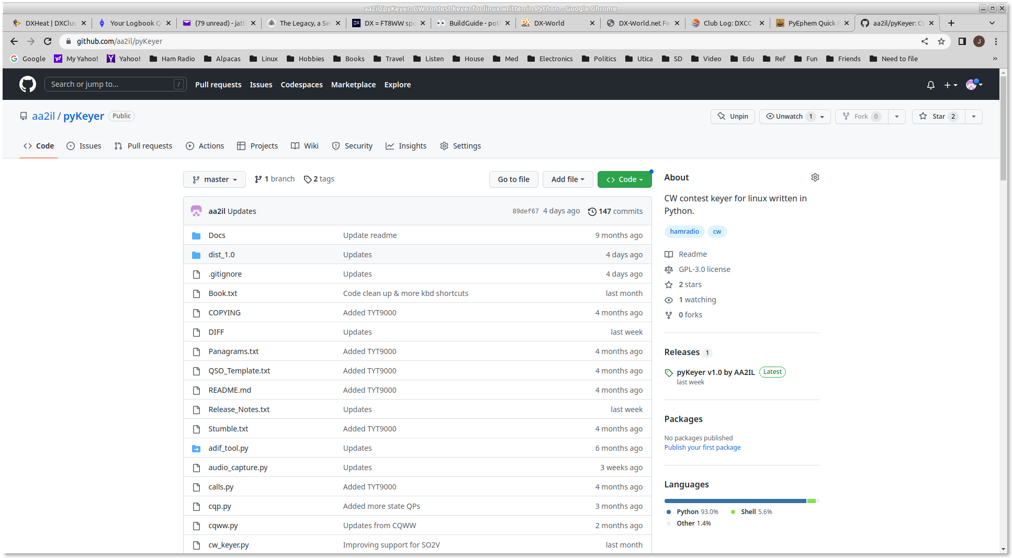
AA2IL Homebrew Software
Source and some binaries are available at github.com/aa2il
  Integrated suite of apps
  Developed under linux but most recently ported to Windoz
  Windoz binaries also available – see “Releases” on RHSs
  Very little documentation
  Would welcome collaboration!
pyKeyer
  Contest rig control (via flrig) and logging
  Practice mode for contests and sending
bandmap
  DX Cluster spots
  Worked/”Need” tracking
wclock – World clock with gray-line map
pySDR
  Software Defined Receiver
  Panadapter
  Does not work yet on Windoz

Slide 132
AA2IL HF Station
SDR
Yaesu
FTdx3000
RX RF
Linux
Computer
CAT Control
Internet
Internet
ISP
Or
Phone
Straight Key Port
Nano IO
Keyer
Paddles
Straight Key

Slide 133
Some Notes from
Intl DX Contest
These were some of the best condx in many years
  20m was open around the clock
This contest is difficult for Low Power stations
  Competing with QRO stations
  Spend a lot of time trying to break pile-ups
RST is always 5NN
Cut numbers for power:
  I always translate these to their numerical equivalent
  According to discussion on CW ops email reflector, the log checking software does recognize 4tt, 1oo, K, KW, etc.

Slide 134
Other Topics – Next Time?
SOTA/POTA
VHF+ and Satellite Contacts
Other games:
  Dear Diary – sending practice, what did you do today?
  Never ending story – each person adds to the story
    It was sunny today
    My dog went outside
    He chased a cat …
Log for Old Men – A couple of students were using this one
Muley had an interesting variation of SST drill where he and I jumped in under other call signs

